Slide 1
Lawrenceville Happenings Meeting:
Crime in Review and Public Safety
03/14/24, 6:30 p.m., CLP - Lawrenceville (279 Fisk St)
Welcome! Please sign in at bit.ly/LUSignIn if joining online

Slide 2
Tonight’s agenda
Welcome & Introductions
Housing: Right to Counsel+ and Housing Choice Vouchers
Review of Crime 2023
Dr. Heath Johnson - Pittsburgh Bureau of Police
Commander Novosel - Zone 2 Police
Better Streets Lawrenceville State of Our Streets 2023
Open Q&A
LU & LC Upcoming Calendars

Slide 3
Accessibility
LU and LC are committed to making these meetings accessible
Let us know about any accommodations you need to fully participate
If joining by Facebook Live, drop comments/questions in the chat

Slide 4
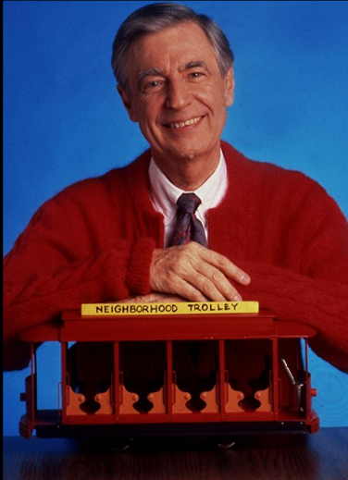
Community Agreements
Be neighborly.
Be respectful of all participants & hosts
Don’t denigrate groups of people
Give space for all to participate

Slide 5
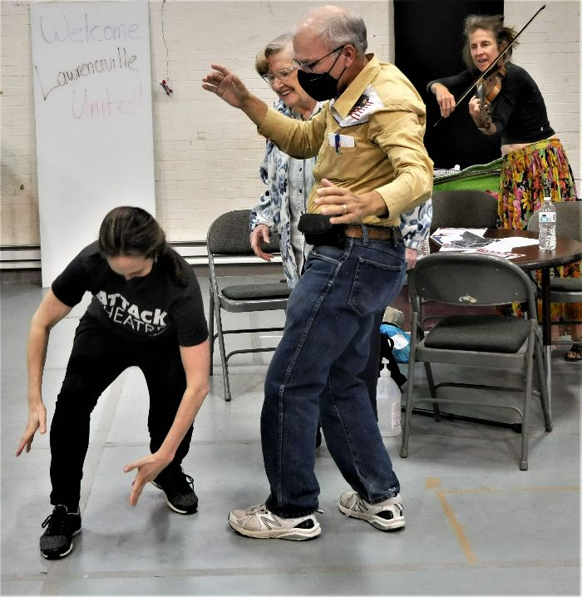
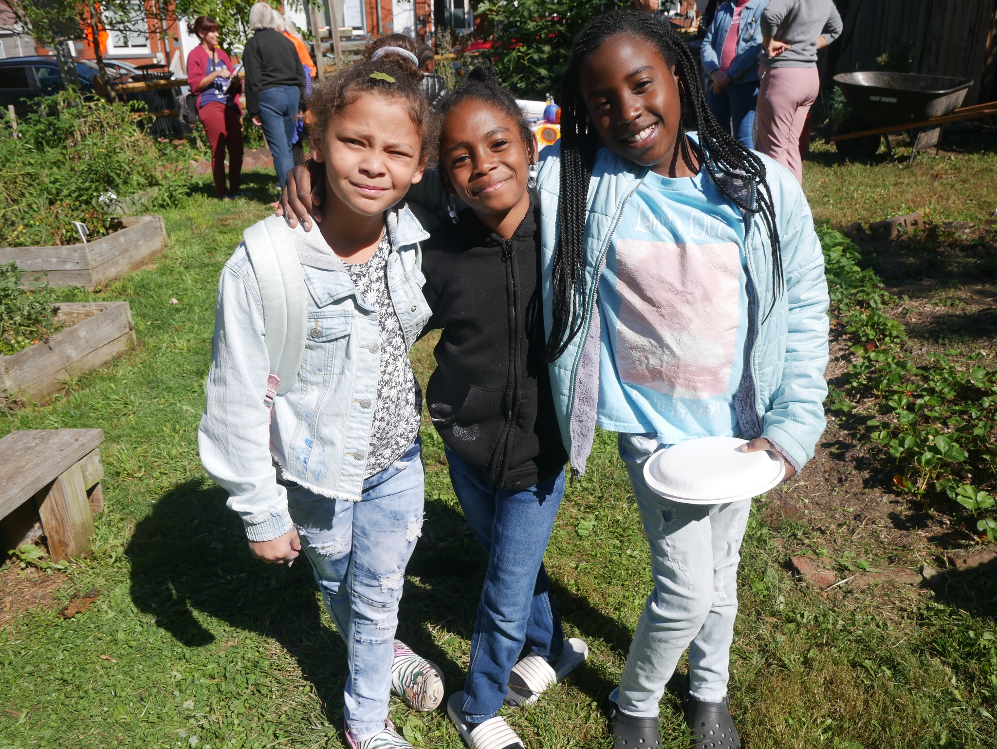
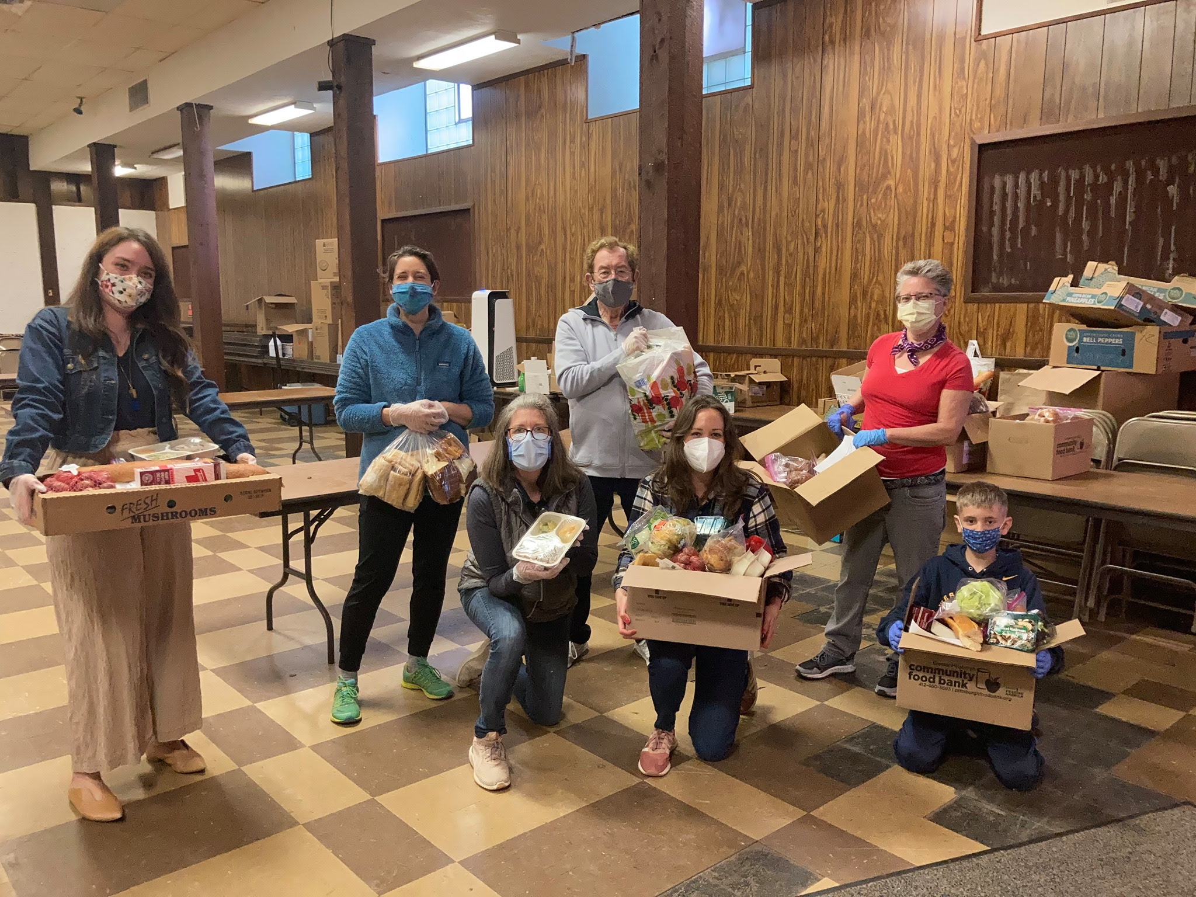
Lawrenceville United
Mission: to improve and protect quality of life for
all Lawrenceville residents
Membership of over 800 residents
Board comprised of all residents: elected by our membership
Programs: Lawrenceville Farmers Market, supporting older adults, free food distributions, cleaning & greening, direct support & case management, advocacy, and more.

Slide 6
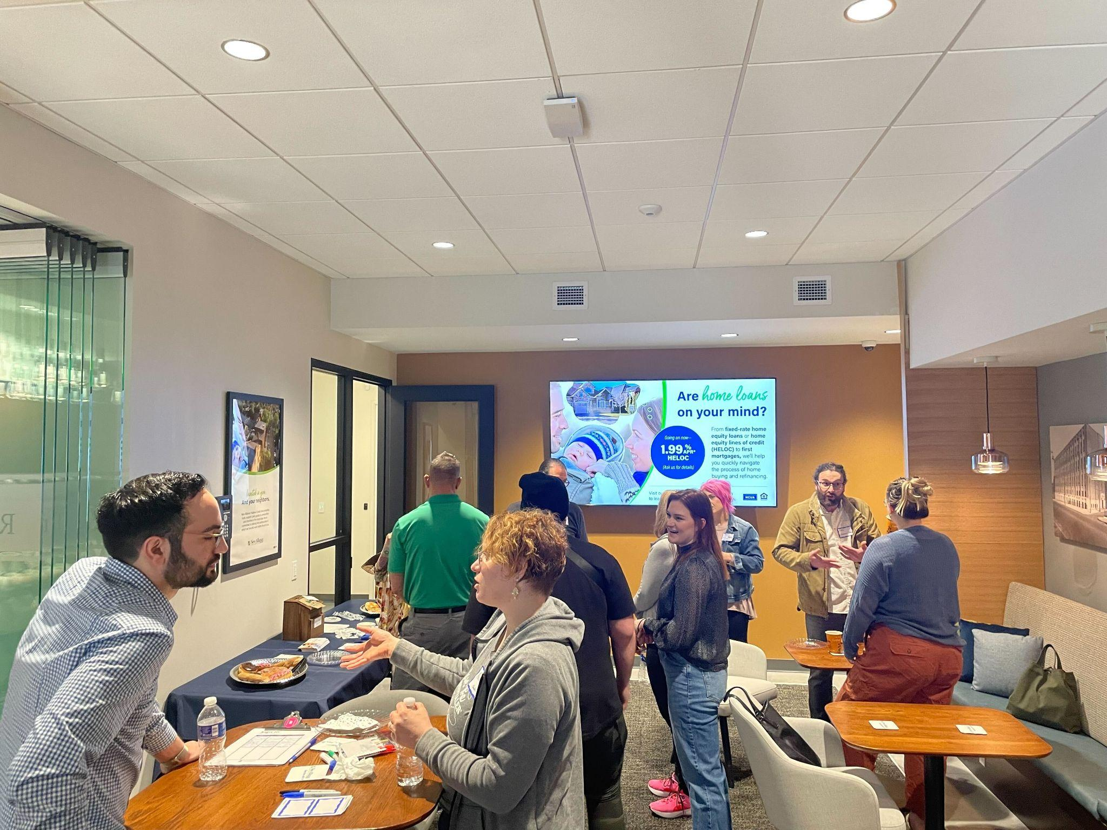
Lawrenceville Corporation
Mission: Driven by the Lawrenceville community, the Lawrenceville Corporation acts as the catalyst and conduit for responsible and sustainable growth.
Membership: About 100, primarily business owners
Board: Mostly comprised of residents, property owners, and business owners and elected by our membership - 16 members
Programs: Business district management, policy and advocacy, community planning and development, real estate development, and communications and marketing

Slide 7
Right to Counsel+
Current project of the Pittsburgh Housing Justice Table that Lawrenceville United co-leads
Would ensure that low-income tenants facing evictions have free legal representation
Pittsburgh’s Lawyer of the Day program provides free legal representation for tenants in some magisterial districts (not Lawrenceville)
Let LU know if you would like to get involved with the Housing Justice Table or LU’s Housing Committee
Sign the petition at bit.ly/RTCnow

Slide 9
Commander Novosel
Zone 2 Police

Slide 10
Dr. Heath C. Johnson
Crime Analysis Coordinator of the Pittsburgh Police

Slide 12
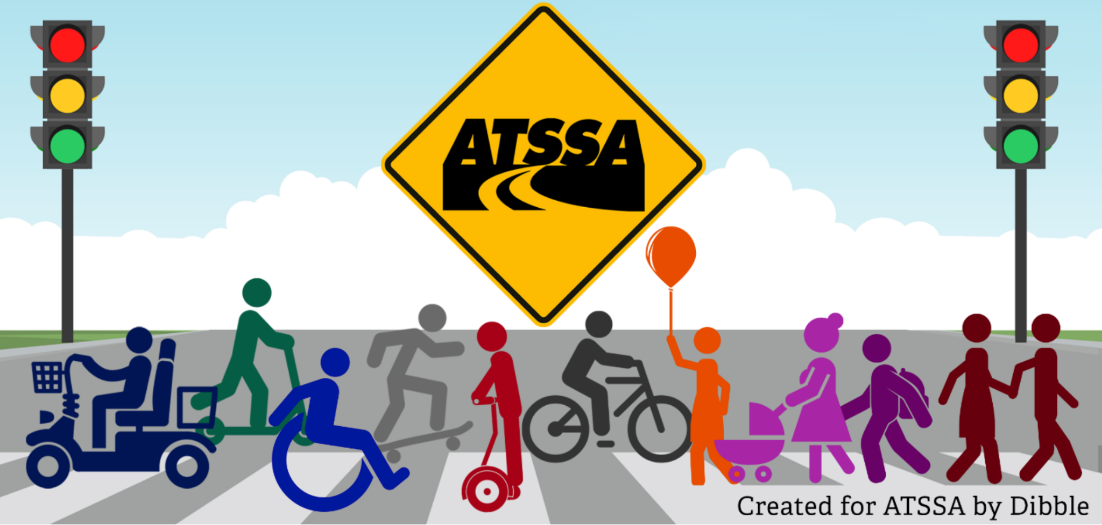
Our Mission
Safe | Convenient | Efficient
Notes:
We’re a group of volunteers
Our mission is to make Lawrenceville’s streets safe, convenient, and efficient for all modes of travel, with a focus on pedestrians, bicyclists, wheelchair-users, stroller-pushers, and bus riders.
Help us make Lawrenceville safer at https://betterstreets.lv

Slide 13
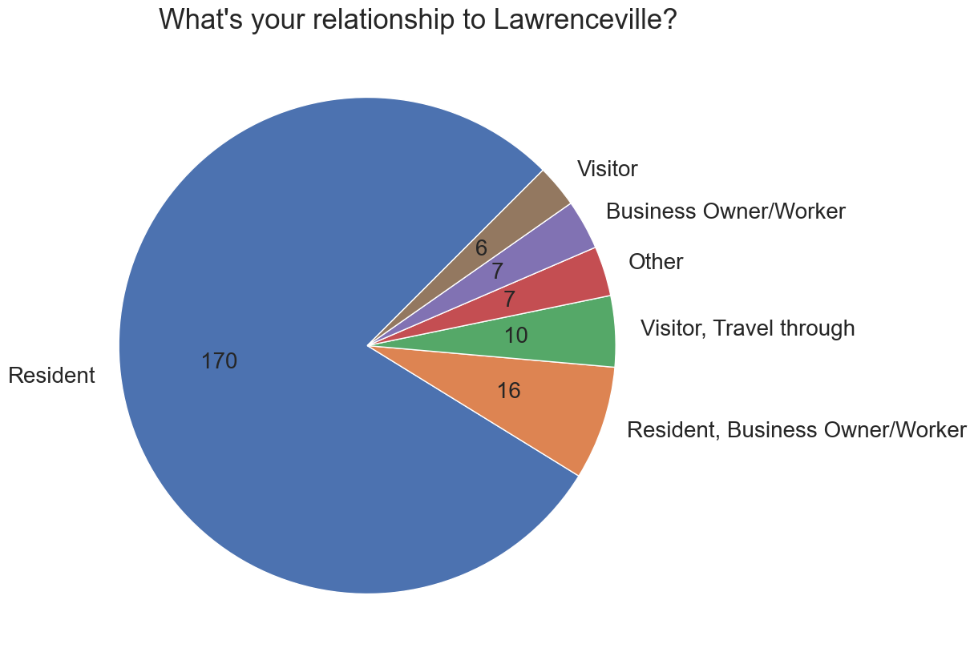
WHO RESPONDED:

Slide 14
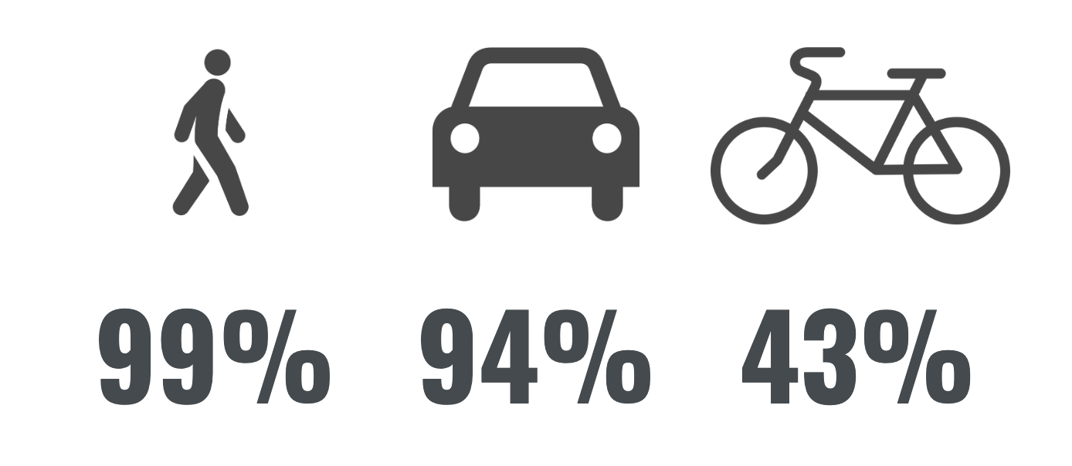
HOW DO PEOPLE GET AROUND?

Slide 15
WHERE DO YOU FEEL SAFE?
Ordered from safest to least safe
Notes:
Sorted by sum of reds: where do people feel least safe?

Slide 16
LEGEND
Unsafe
Very Safe
No Opinion

Slide 17
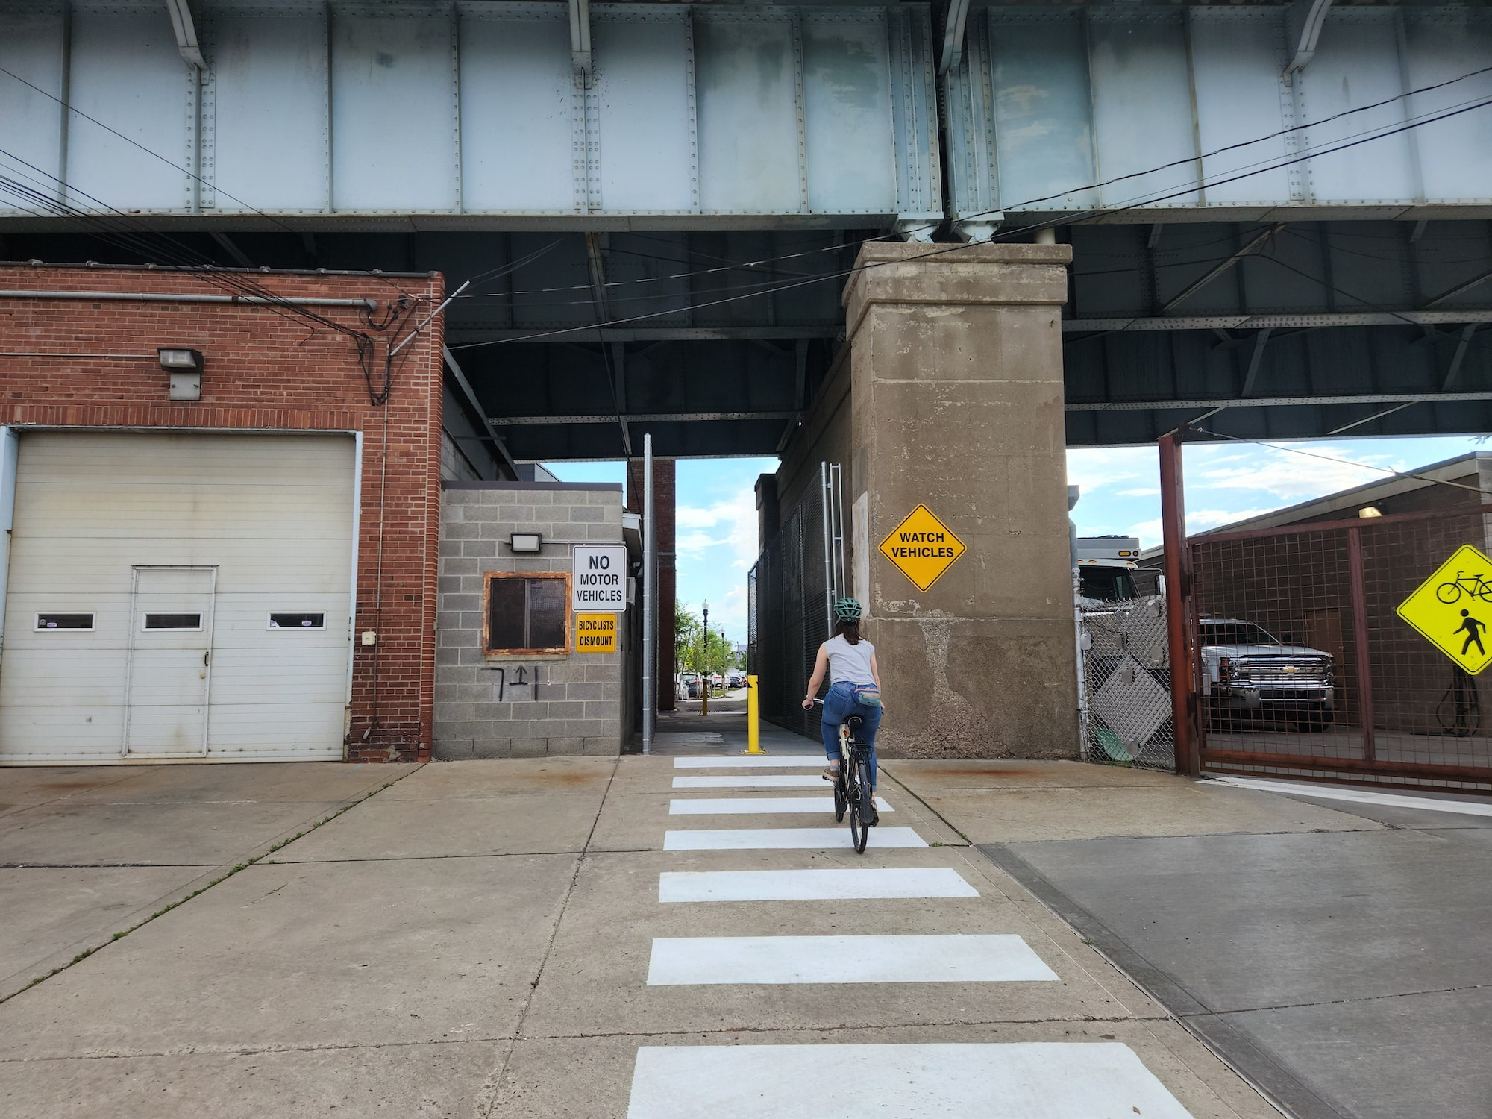
Bike/Ped Passageway Under the 40th Street Bridge
Responses:
Legend:
Unsafe
Very Safe

Slide 18
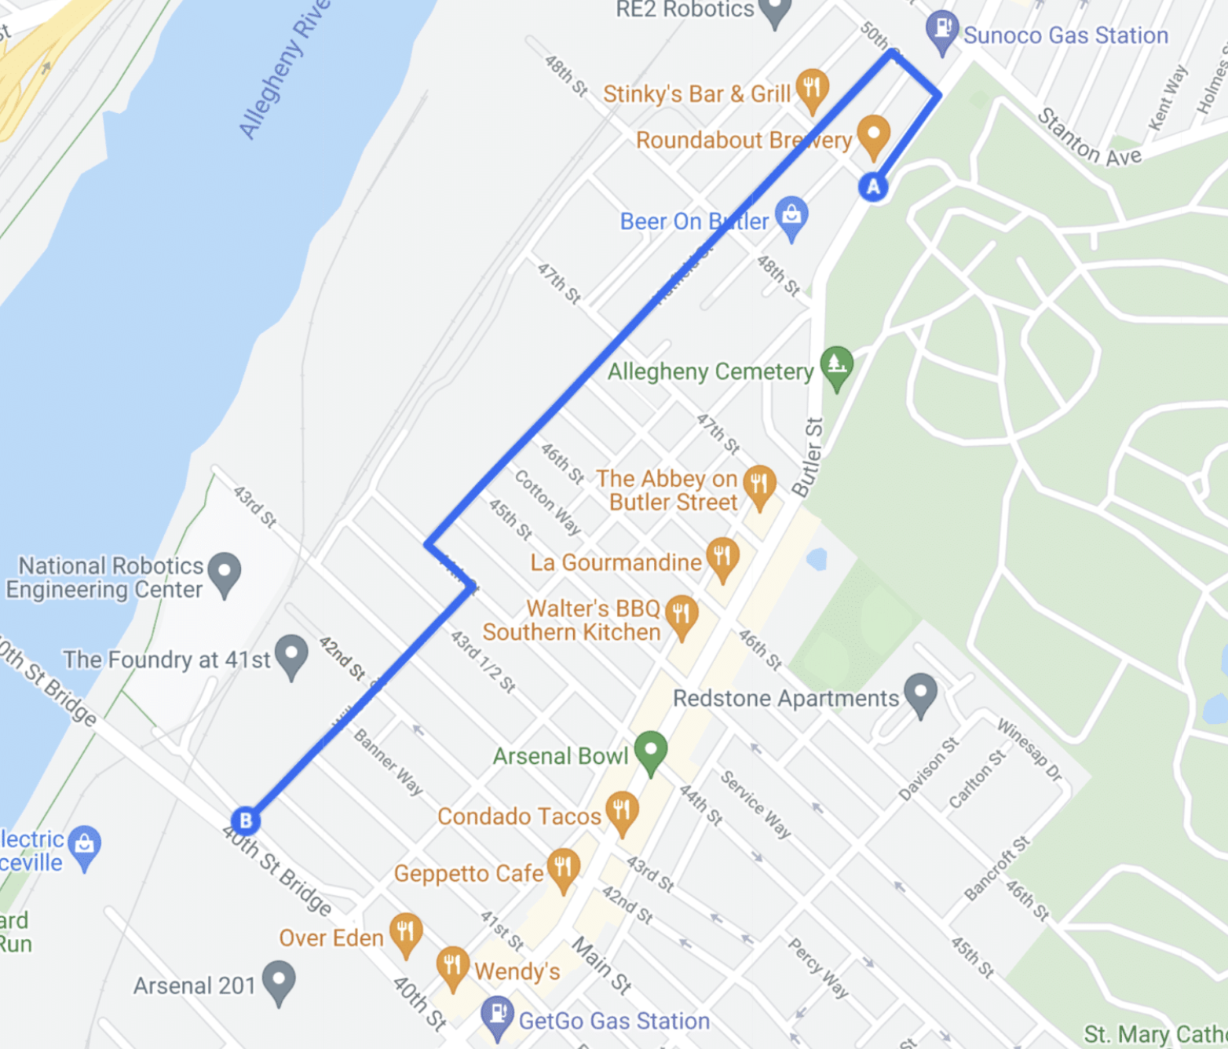
Hatfield/Willow St Neighborway
Responses:
Legend:
Unsafe
Very Safe

Slide 19
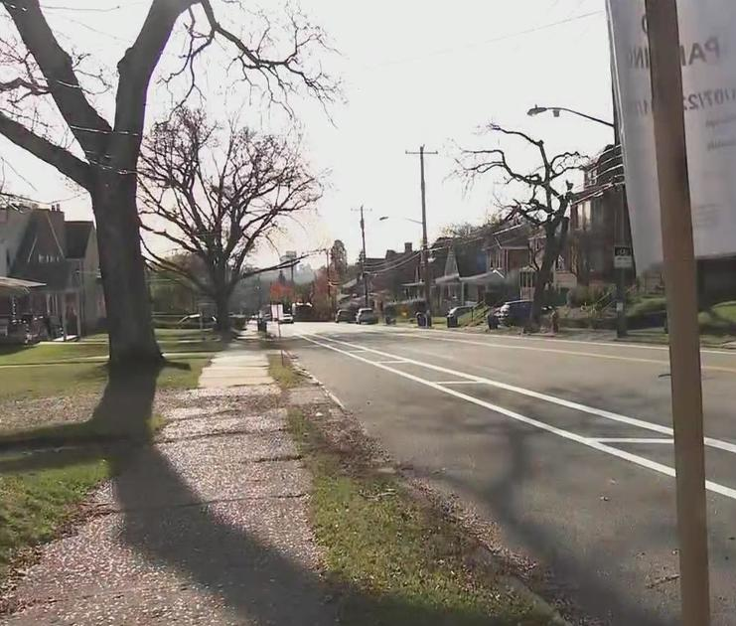
Stanton Ave Bike Lane
Responses:
Legend:
Unsafe
Very Safe

Slide 20
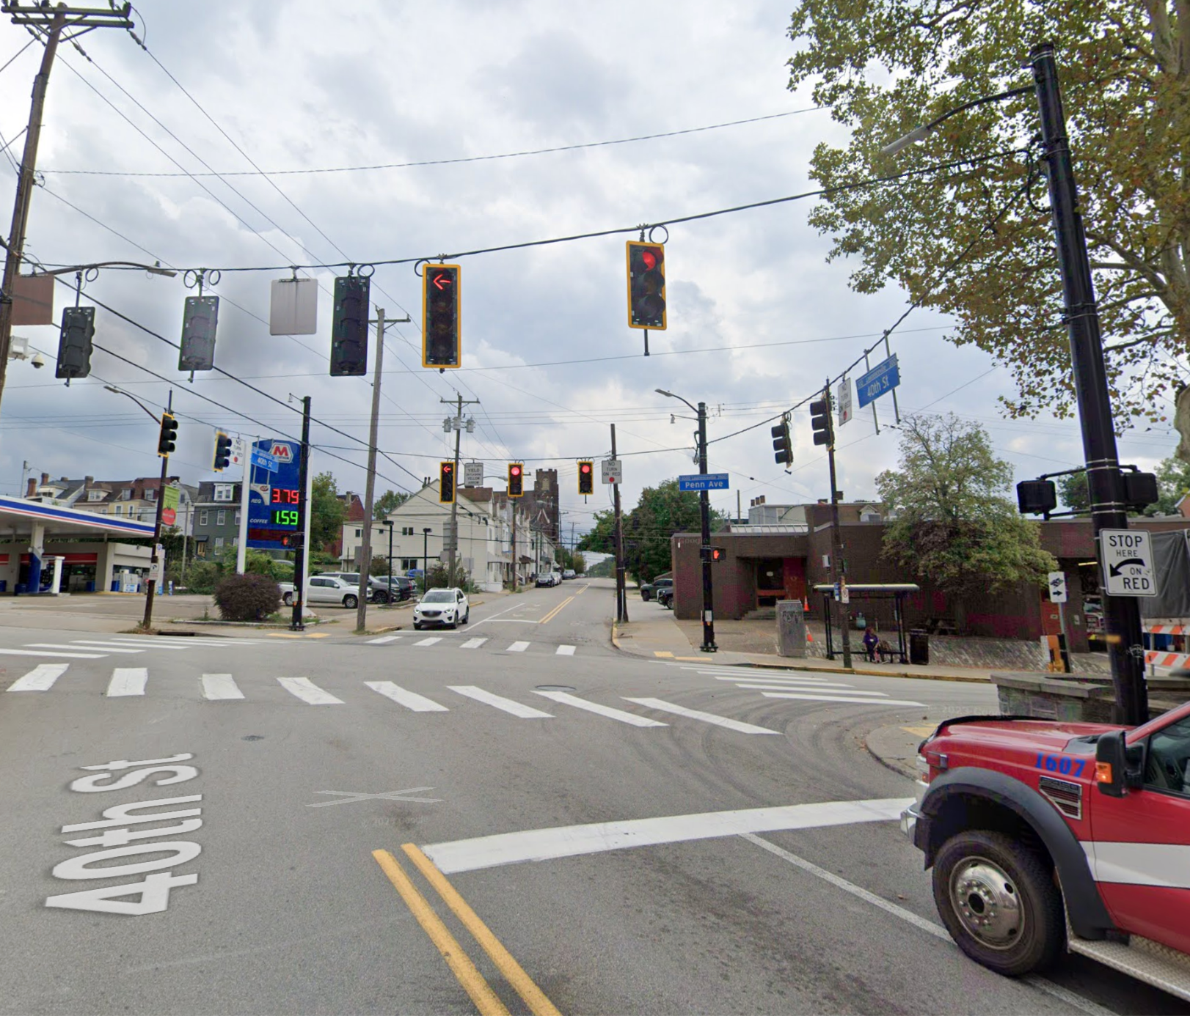
Signal changes at Penn and 40th head start for pedestrian crossing signals, updated traffic lights
Responses:
Legend:
Unsafe
Very Safe

Slide 21
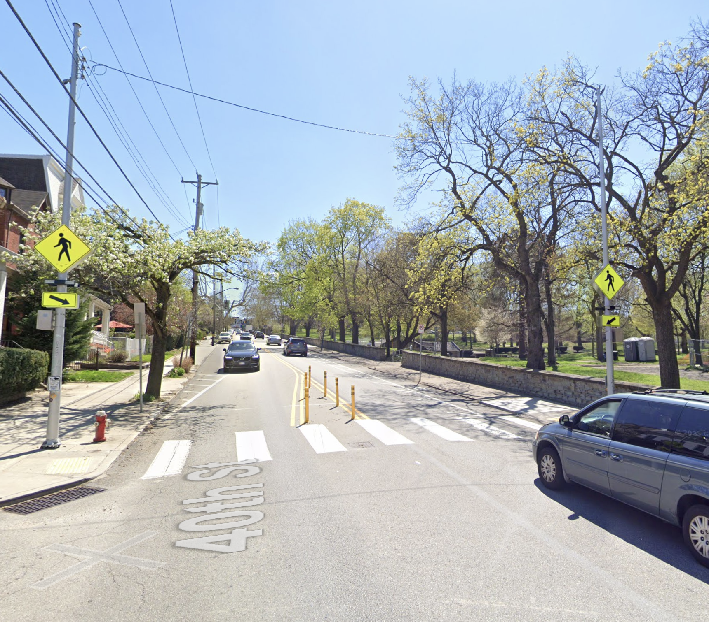
40th St Bike Lane between Butler and Penn
Responses:
Legend:
Unsafe
Very Safe

Slide 22
Flashing pedestrian crossing signal at 40th and Davison by entrance to Arsenal Park
Responses:
Legend:
Unsafe
Very Safe

Slide 23
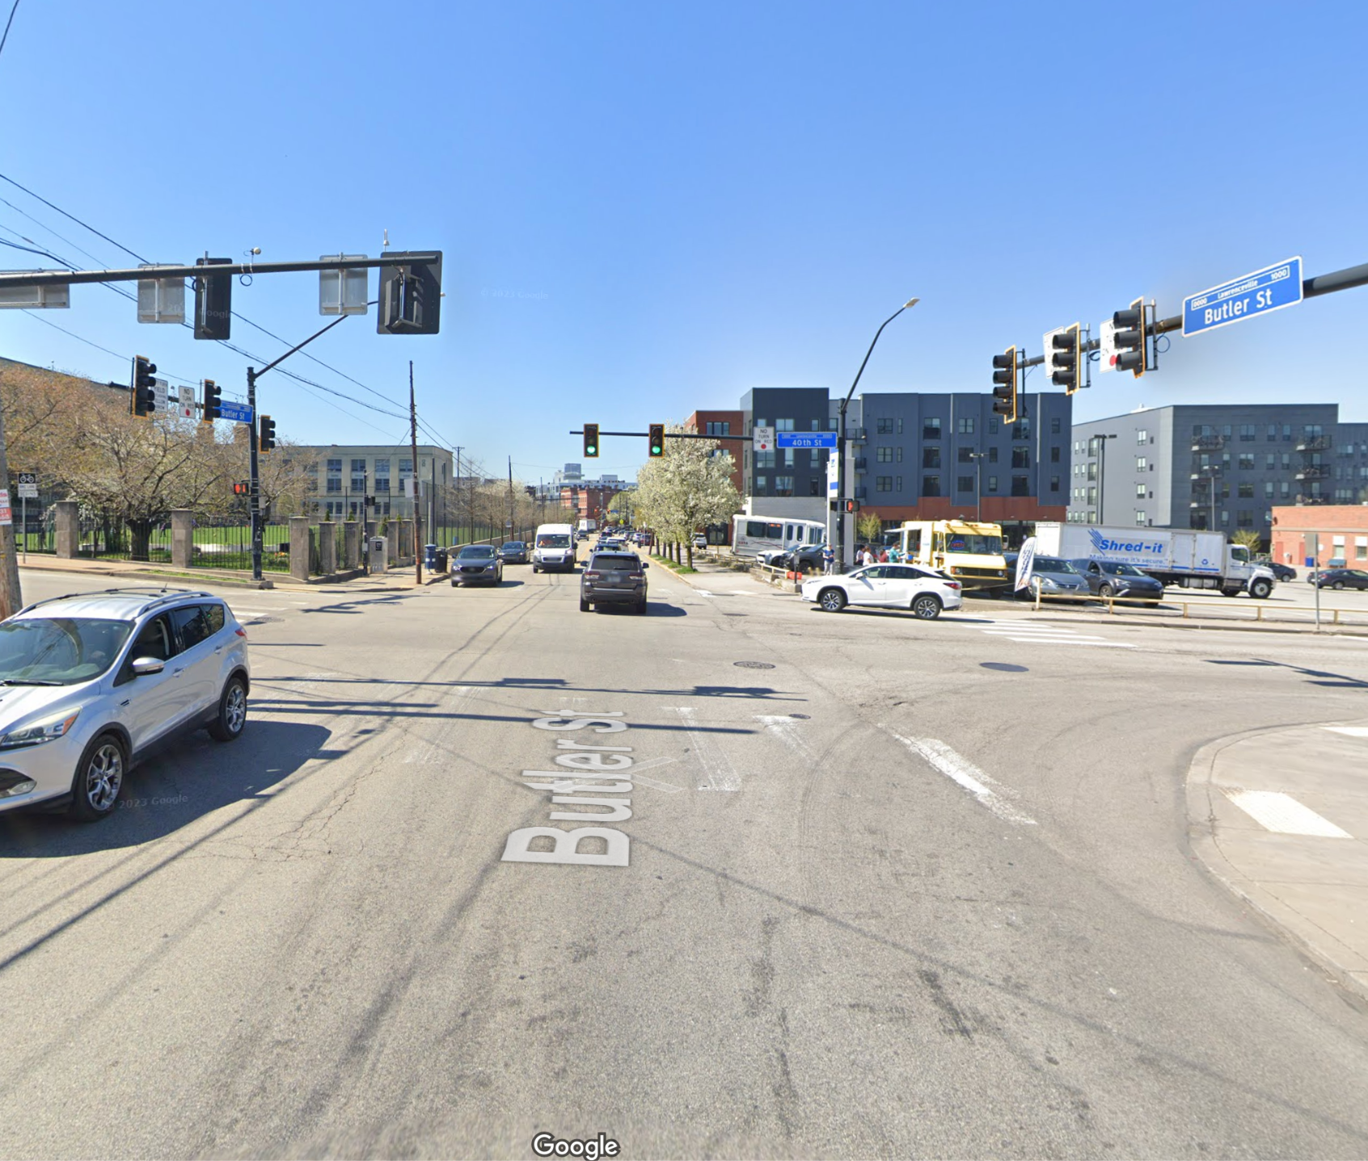
Signal changes at Butler and 40th head start for pedestrian crossing signals, updated traffic lights
Responses:
Legend:
Unsafe
Very Safe

Slide 24
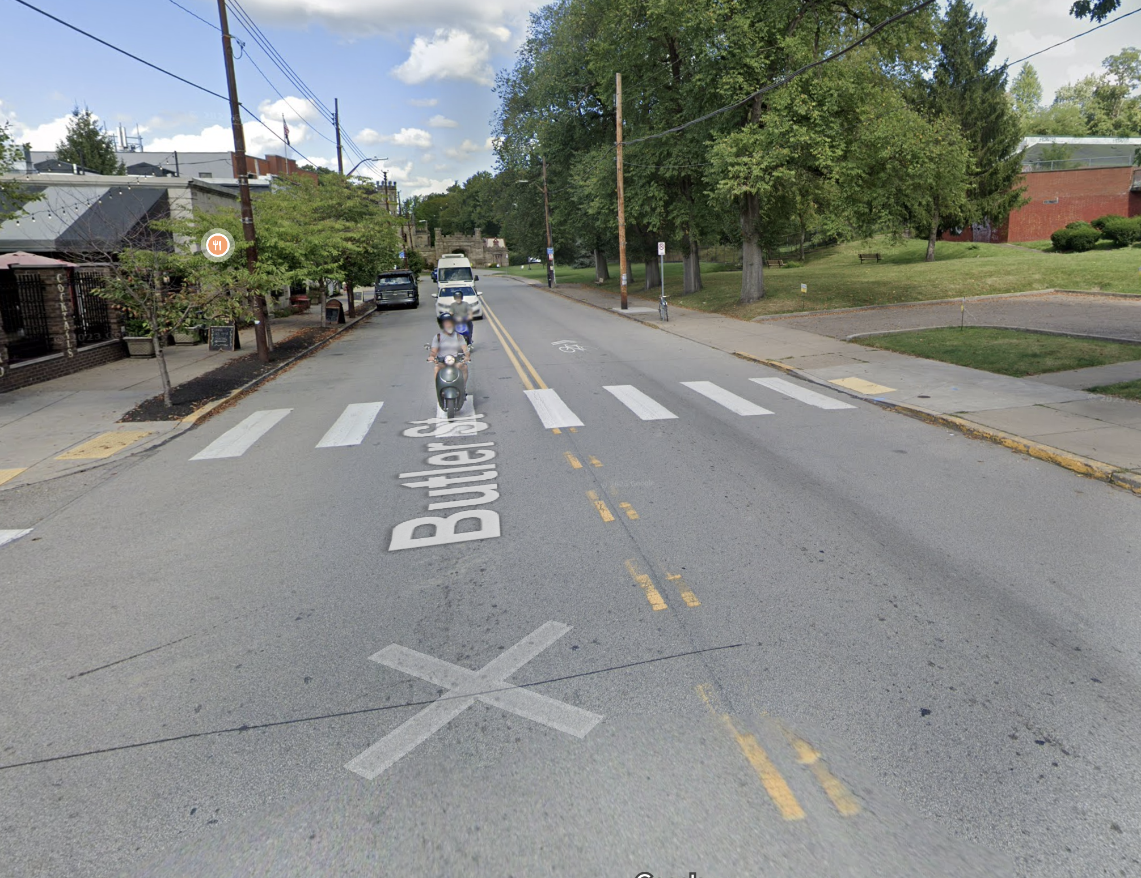
Crossing at Home and Butler St By Healthy Active Living Center / Boys and Girls Club
Responses:
Legend:
Unsafe
Very Safe

Slide 25
PRIORITIES
Ordered from highest to lowest
Notes:
Sorted by sum of reds: where do people feel least safe?

Slide 26
LEGEND
Not Important
Very Important
No Opinion

Slide 27
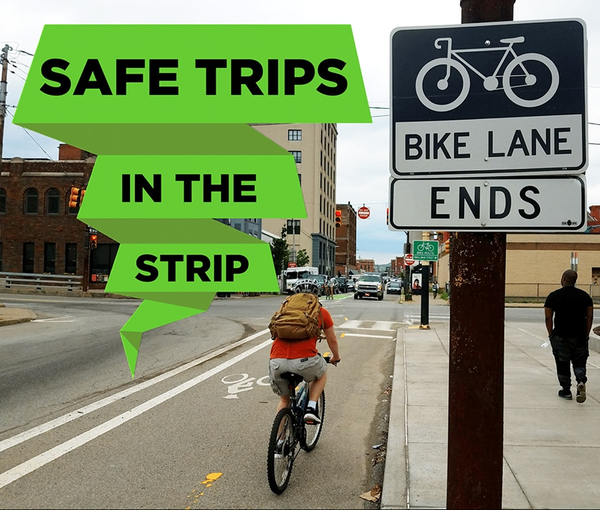
Safe Bike Route Through the Strip Creation of a protected/separated bike route to the Strip District and Downtown
Responses:
Legend (how important):
Not
Very

Slide 28
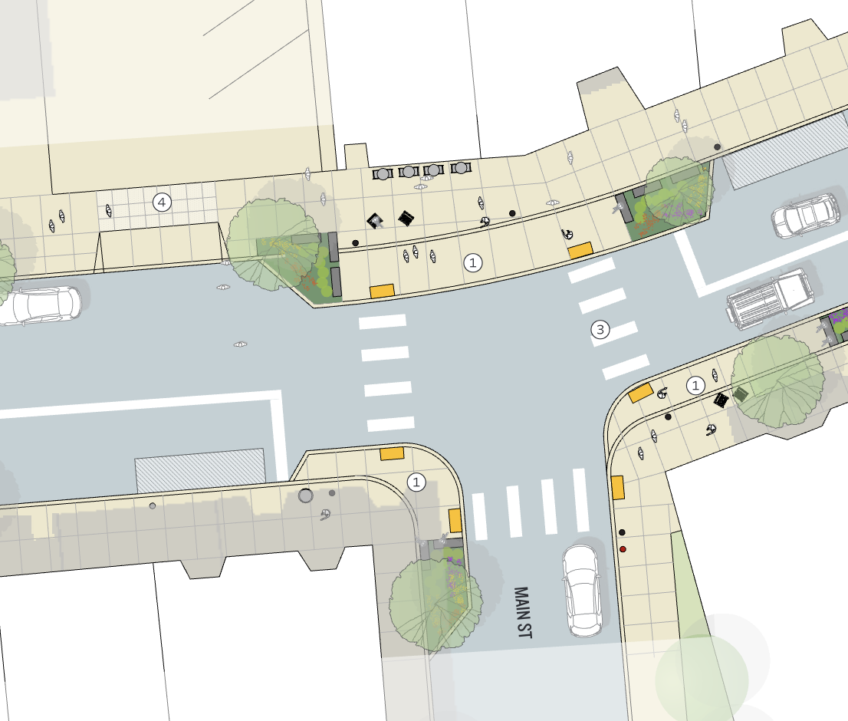
Butler and Main Sidewalk Improvements Sidewalk expansion and curb bump-outs at intersection of Butler and Main
Responses:
Legend (how important):
Not
Very

Slide 29
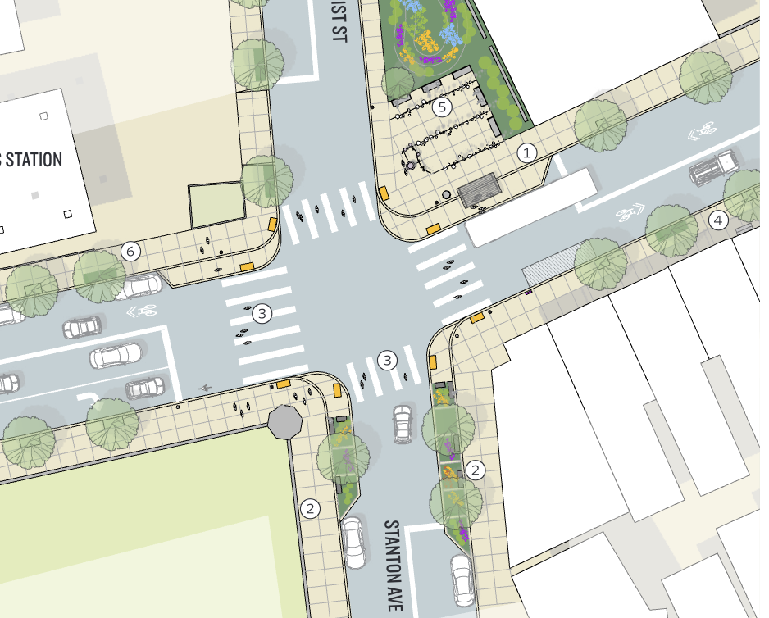
Safety Improvements At Butler + Stanton/51st
Responses:
Legend (how important):
Not
Very

Slide 30
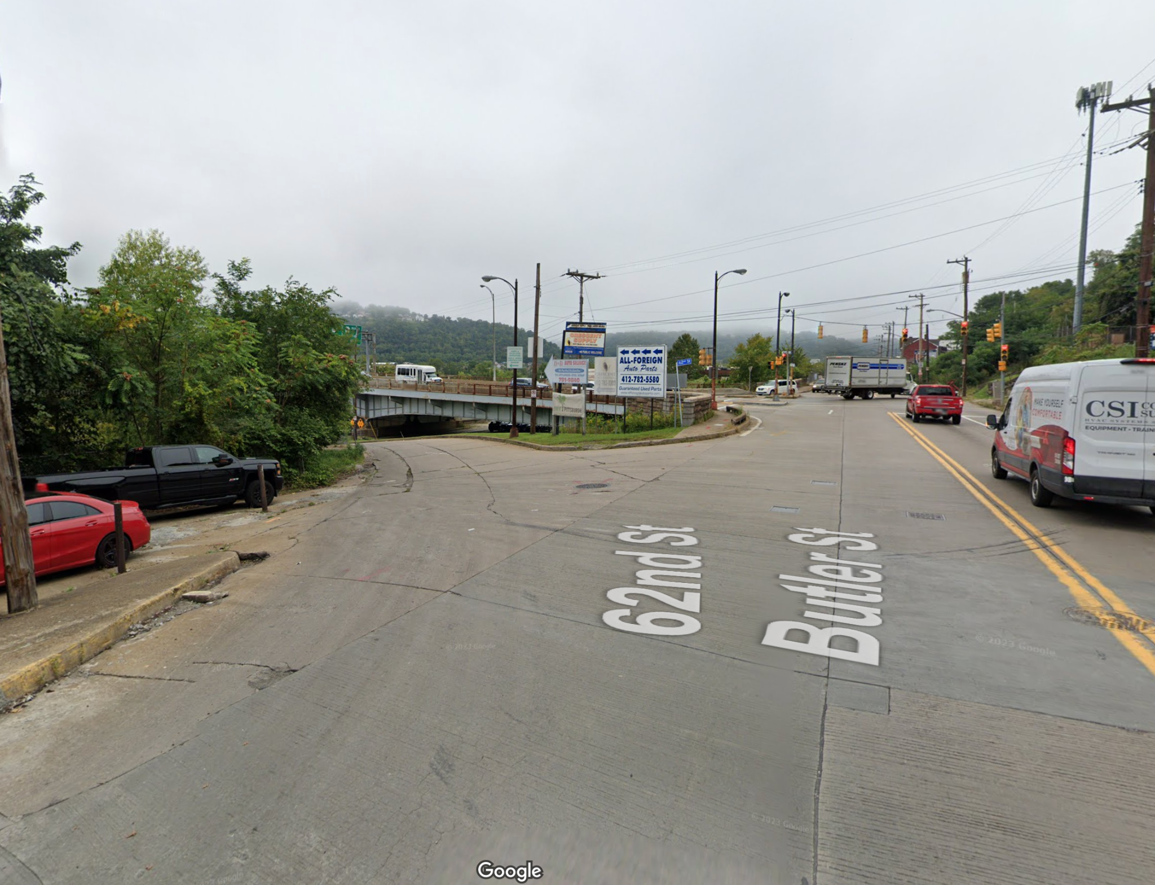
Bike lanes in Upper Lawrenceville Along Butler Street (above 57th) and redesign of 62nd St and Butler Intersection
Responses:
Legend (how important):
Not
Very

Slide 31
TOP ISSUES
Starting with the biggest issues

Slide 32
LEGEND
Not an issue
Big issue
No Opinion

Slide 33
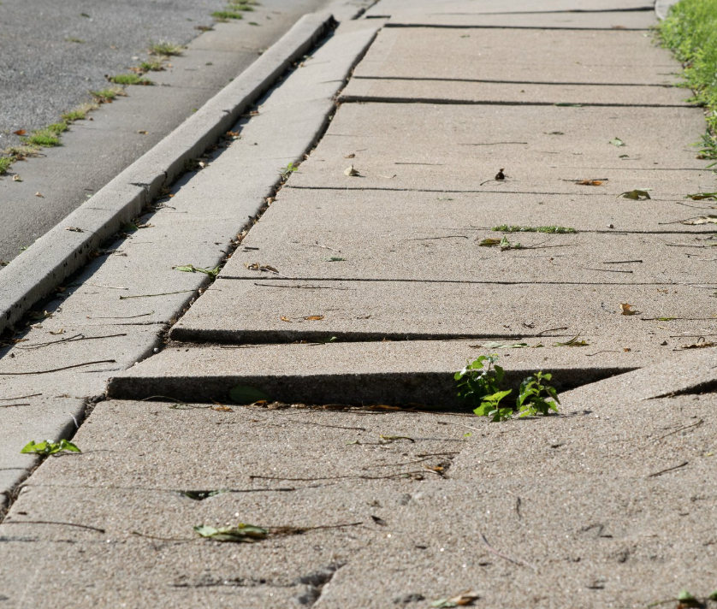
Sidewalks not Maintained (broken pavement)
Responses:
Legend:
Not an issue
Big issue

Slide 34
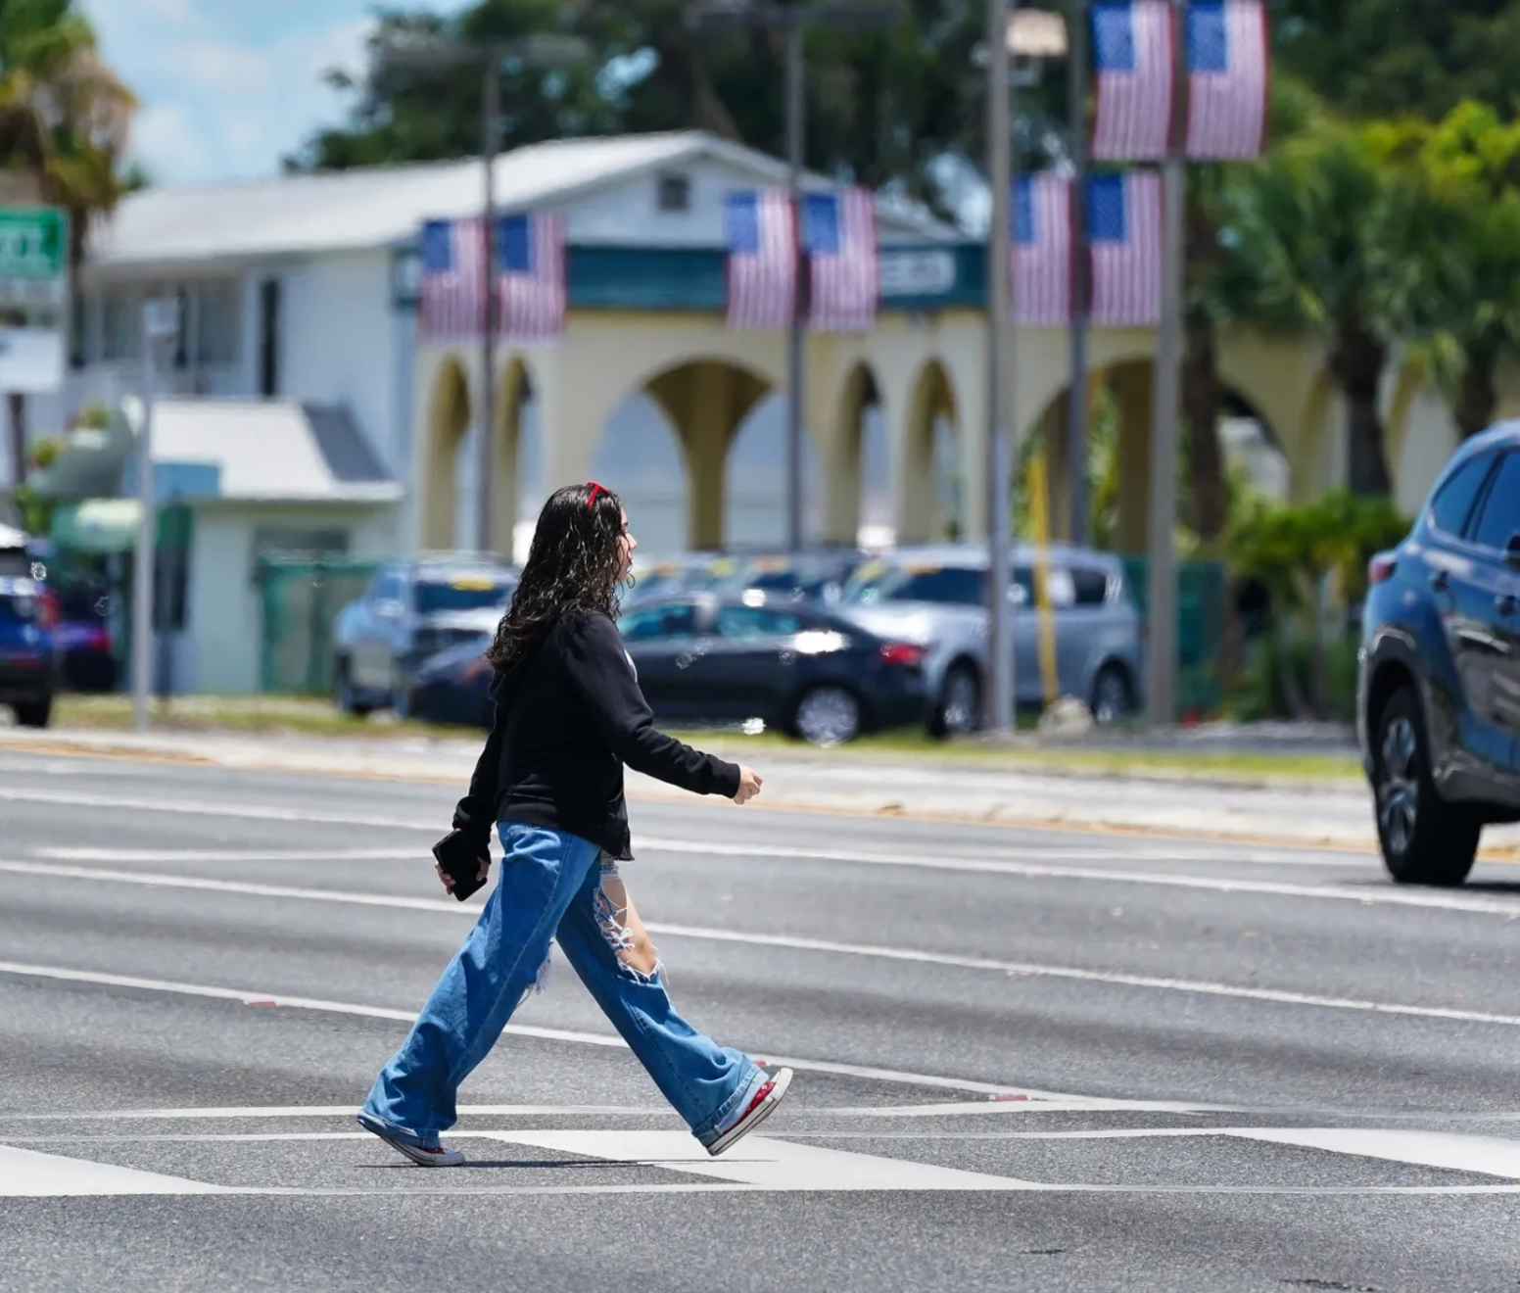
Lack of safe crossings at busy intersections
Responses:
Legend:
Not an issue
Big issue

Slide 35
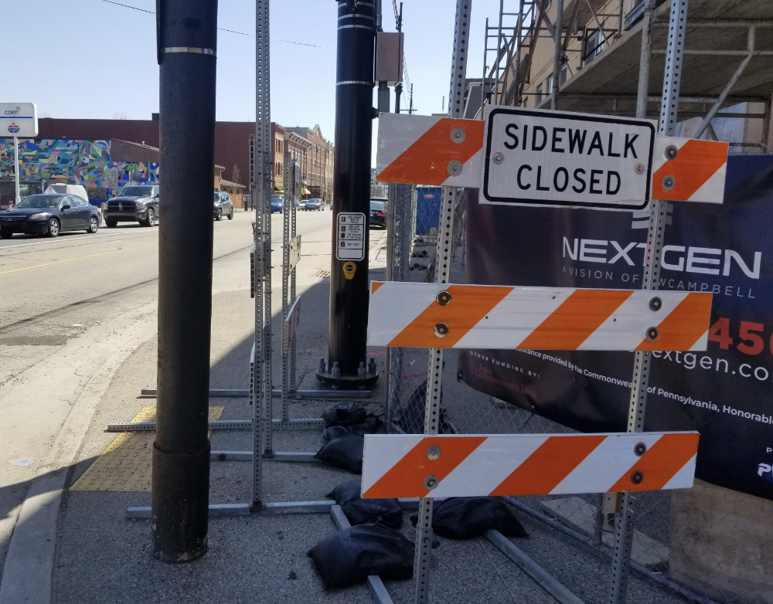
Construction blocking the sidewalk
Responses:
Legend:
Not an issue
Big issue

Slide 36
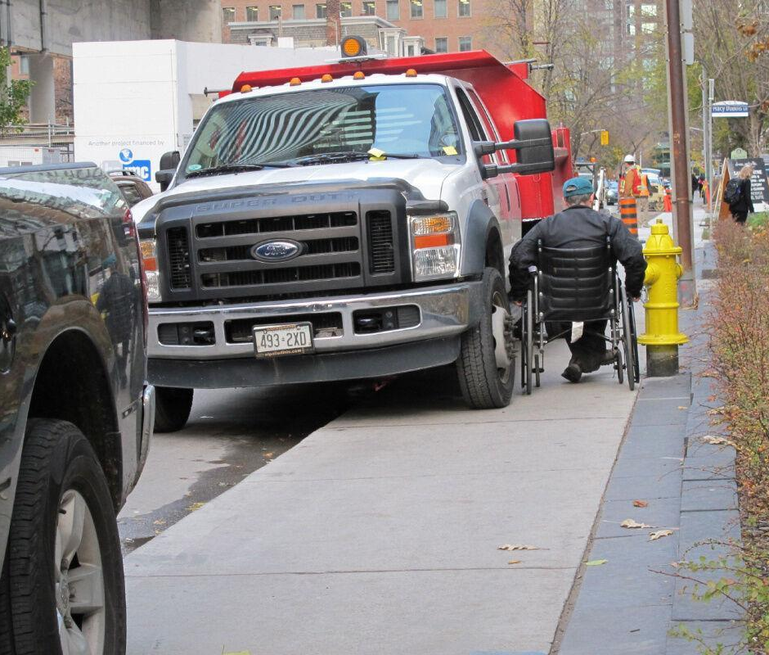
Cars parked on the sidewalk
Responses:
Legend:
Not an issue
Big issue

Slide 37
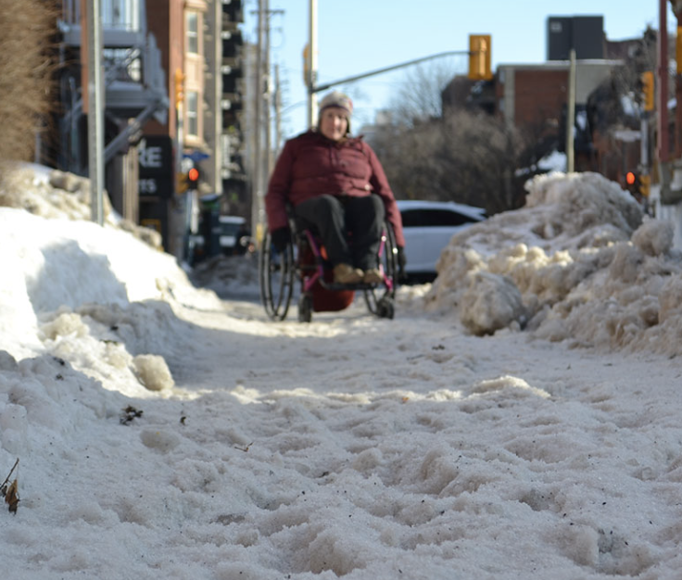
Sidewalks not cleared of snow
Responses:
Legend:
Not an issue
Big issue

Slide 38
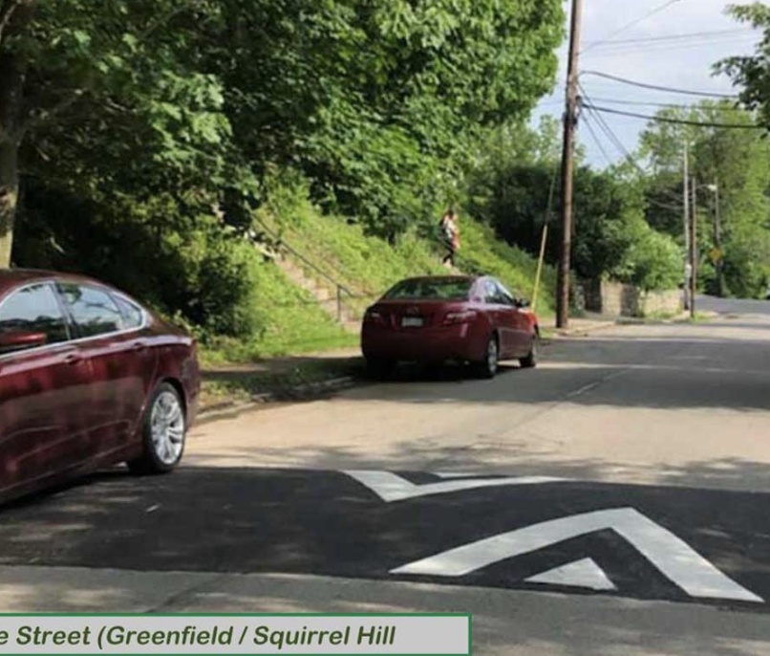
Need for traffic calming infrastructure on specific streets (for example, speed humps or curb bump-outs)
Responses:
Legend:
Not an issue
Big issue

Slide 39
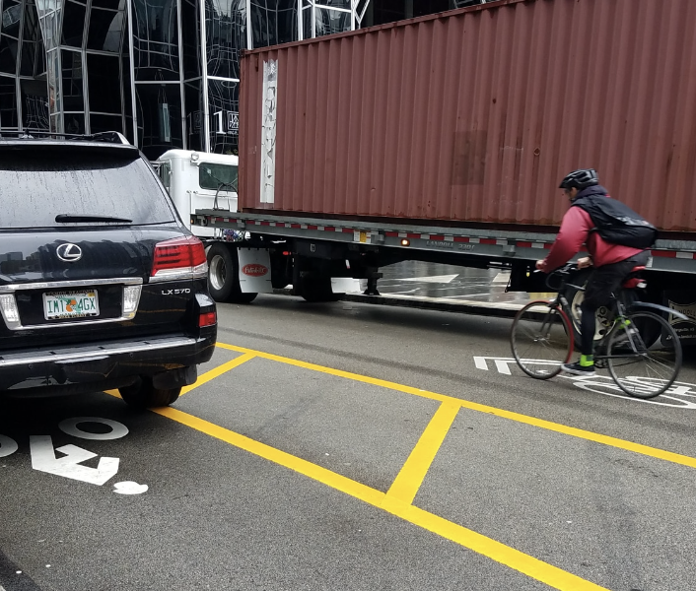
Cars parked in bike lanes
Responses:
Legend:
Not an issue
Big issue

Slide 40
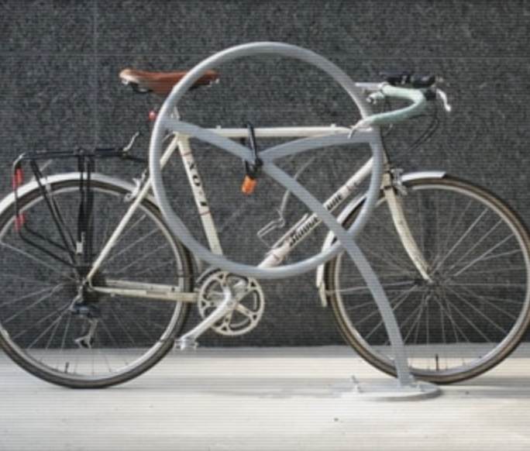
Need for more bike parking
Responses:
Legend:
Not an issue
Big issue

Slide 41
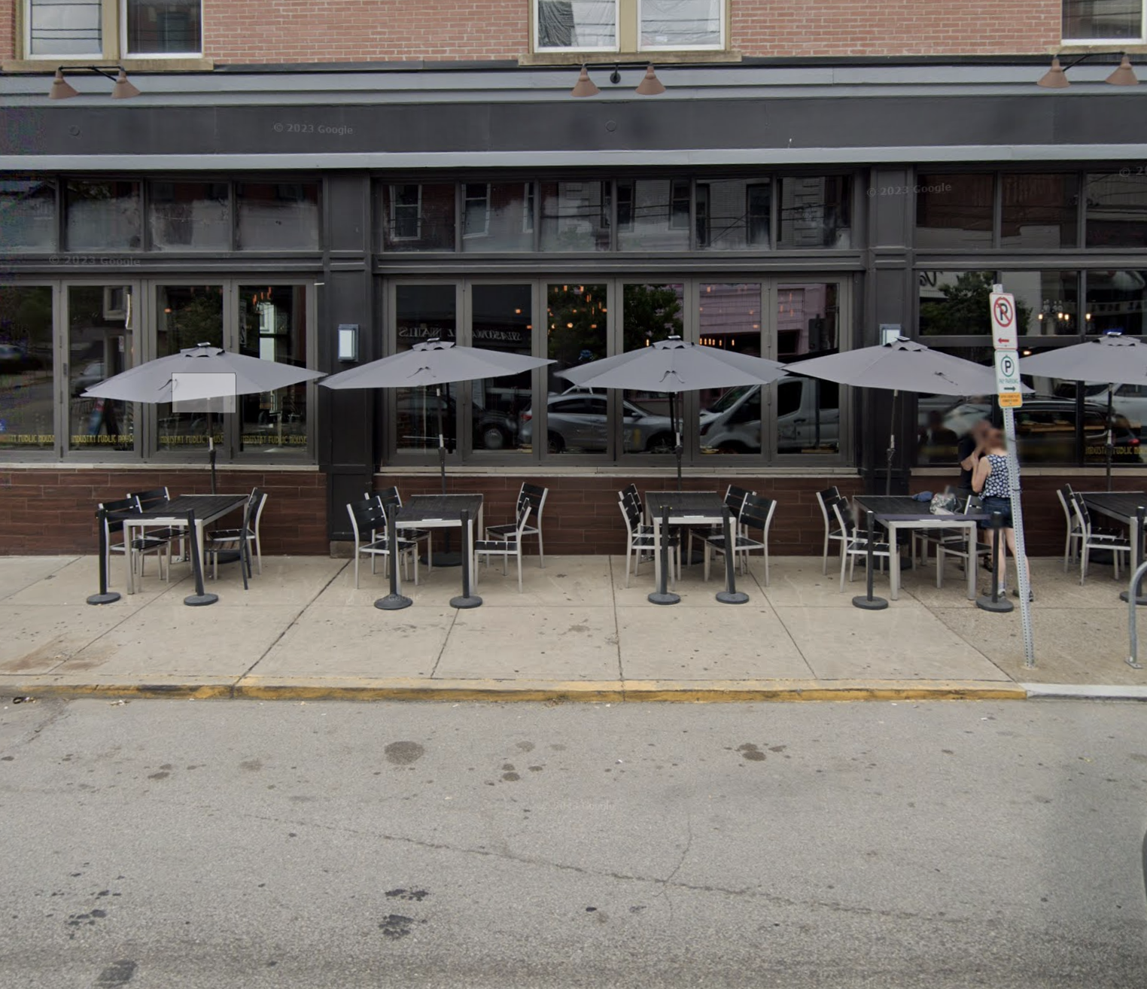
Sidewalk blocked by restaurant seating
Responses:
Legend:
Not an issue
Big issue

Slide 42
FREEFORM FEEDBACK

Slide 43
Specific streets called out for being unsafe:
Butler | Main | Penn | Foster | Davison
9 people | 6 people | 4 people | 3 people | 2 people
Specific illegal behavior called out:
Parking on Sidewalks | Speeding | Parking in Intersections
16 people | 19 people | 14 people
Other issues:
Damaged Sidewalks | Not Enough Parking | Trash | Construction Issues
10 people | 6 people | 6 people | 5 people

Slide 44
How you wanted issues resolved:
43 people | Asked for better enforcement Including speed limits, stop signs, and illegal parking
24 people | Asked for safer bike infrastructure Including bike lanes and neighborways
20 people | Asked for more traffic calming
20 people | Asked for better daylighting Removing obstructions at intersections for better visibility
15 people | Asked for more traffic signals
11 people | Asked for more one-way streets

Slide 45
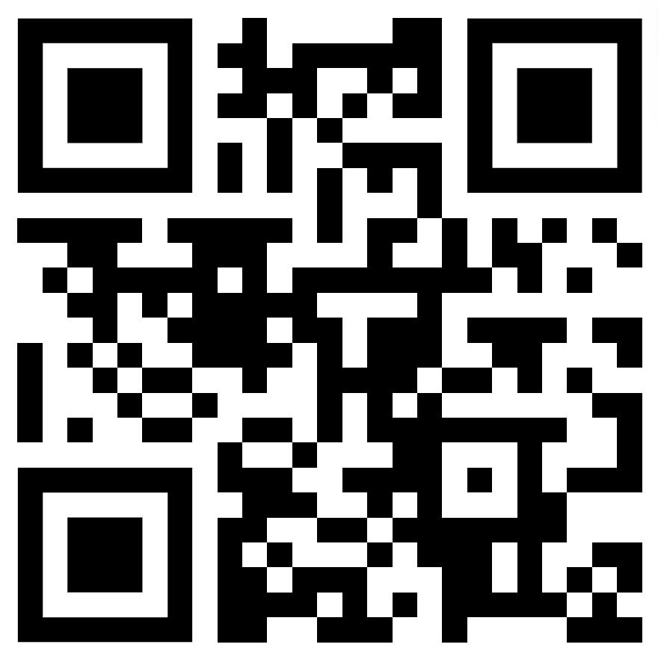
Created by the volunteers at Better Streets Lawrenceville. Help us make Lawrenceville streets better at www.betterstreets.lv

Slide 46
OPEN Q&A

Slide 47
Upcoming Calendar
3/27 - Coffee + Tea Business Networking at Lola’s
3/28 - CDAM on Mobility Enhancement District
4/11 - Flower Arranging for AdvantAGE members
4/11 - Lawrenceville Volunteer and Advocacy Fair
4/13 - Bernard Dog Park Clean Up
4/20 - Tree Plantings (Penn Ave and Arsenal Park)
4/24 - Butler Street Clean Up and Sips and Brews
4/27 - First Duncan Park Workday
5/21 - Lawrenceville Farmers Market Opening Day
6/15 - Lawrenceville Pride

Slide 48
Comments, questions
Lawrenceville United Lawrenceville Corporation
412-802-7220 412-621-1616
info@LUnited.org info@lawrencevillecorp.com
If you joined online, please sign in bit.ly/LUSignIn if joining online

