Slide 1
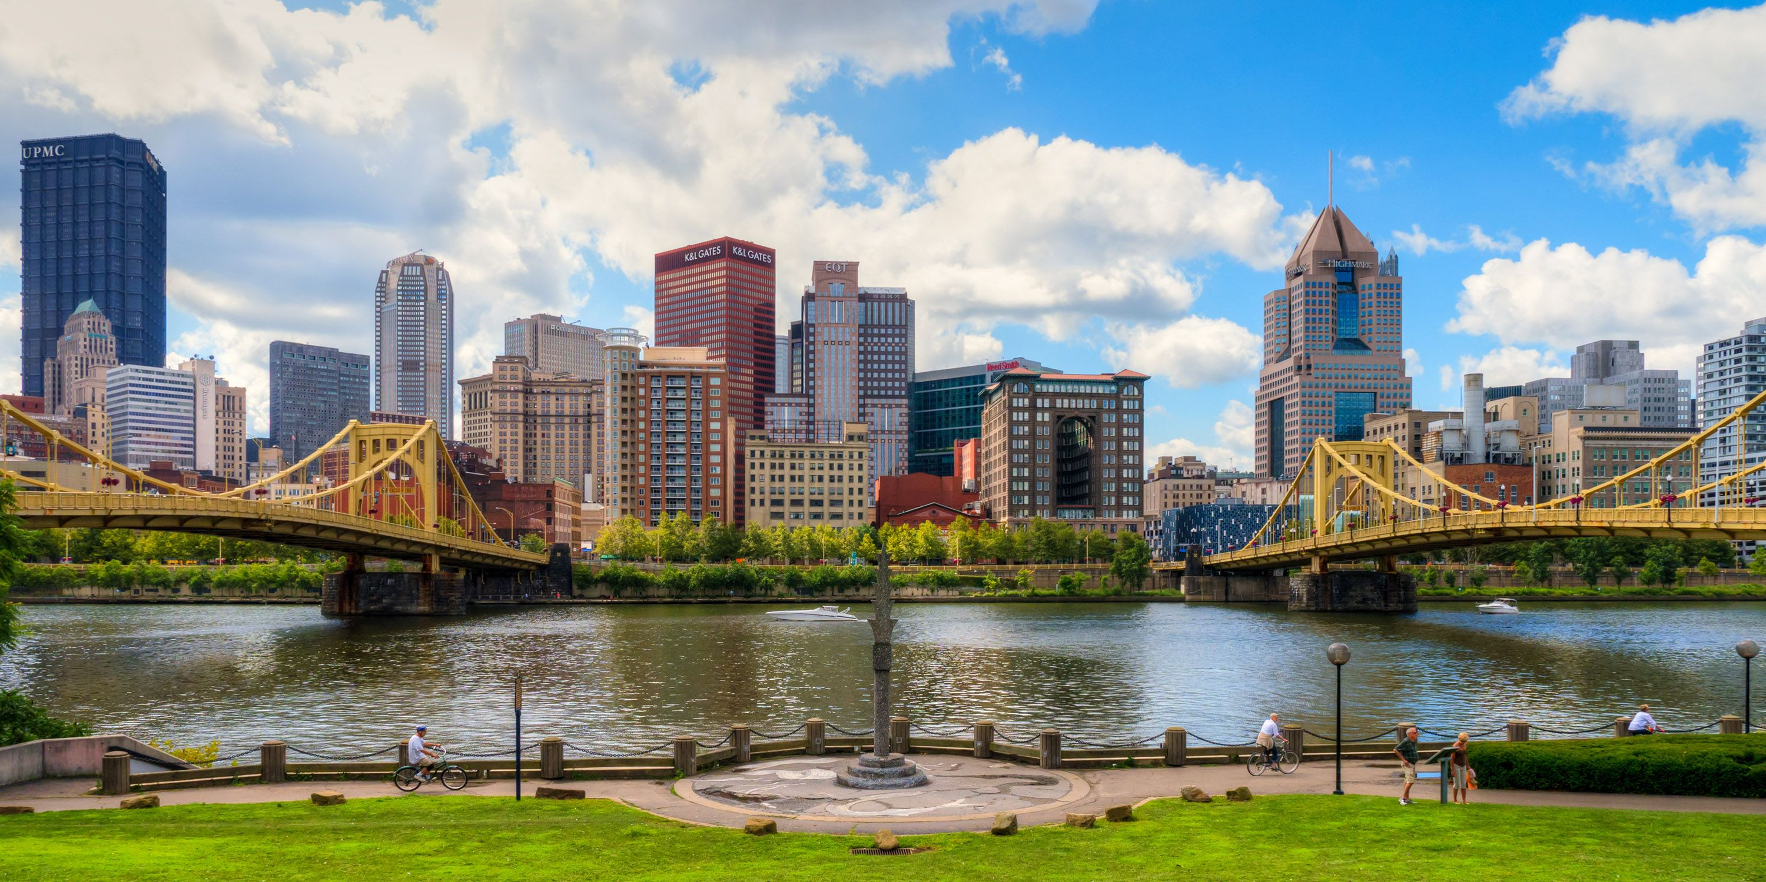



Housing Opportunity Fund:
2024 Annual Allocation Plan Survey
July 13, 2023

Slide 2

Housing Opportunity Fund Timeline
Housing Opportunity Fund created by City Council legislation
Housing Needs Assessment identifies 20,000 unit gap for households earning 50% AMI or less
First projects approved for funding
2015
2016
2017
2018
2019
2020
Affordable Housing Task Force established
Affordable Housing Task Force recommends creating Housing Opportunity Fund (HOF)
City Council votes to fund HOF at $10M per year (to help offset the HOF reserve, the City increased the RTT by 1% in 2020
Mayor appoints 17-person Advisory Board
First Roof-a-thon completed!
Notes:
Here is a little bit of history for context.
AHTF Legislation was introduced and passed in early 2015 to establish an Affordable Housing Task force. The task force was charged with investigating Affordable Housing critical needs and advancing recommendations for solutions to address those needs.
The AHTF commissioned a Housing Needs Assessment in May 2016. One of the major findings was that we need 20,000 more units for households earning 50% of AMI or less. In Pittsburgh that is $26,600 for a single person and $38,000 for a family of four. One of the big applications of affordable and workforce housing for economic development lies in retaining and attracting younger people into the area – an aging workforce is an almost universal challenge that applies to communities of all sizes.
Returning to the assessment, the AHTF recommended five things:
1. Create a Housing Opportunity Fund
2. Increase the Use of the 4% Low Income Housing Task Credit
3. Create an Inclusionary Housing Policy for the City
4. Create an Affordable Housing Database and devise a strategy to preserve affordable units when the deed restrictions will expire
5. Create programs to protect existing homeowners and tenants
Advisory Board members represent:
Local government
Housing advocates
Community members impacted by housing affordability and insecurity
The nonprofit and for-profit development community
Financial institutions
Three governing boards:
Advisory Board
URA Board
City Council

Slide 3

Housing Opportunity Fund Overview
Advisory Board
17 Pittsburgh residents with varying occupations and socioeconomic backgrounds
Reviews applications and guides program development
Governing Board
URA Board: votes on projects and votes to advance Annual Allocation Plan (AAP) to City Council
City Council
Votes on proposed allocation plan
Eligible Uses of Funds:
Create and preserve affordable housing for rent and
for-sale
Focus on deed restricted and/or permanently affordable housing
Expand access for seniors and people with disabilities
Increase number of affordable homes with supportive services to prevent homelessness
Stabilize neighborhoods
Identify and secure additional funding opportunities
for HOF
Annual Allocation Plan
URA must collect public feedback prior to the passage of the next year’s AAP
Draft AAP must be approved by the Advisory Board, URA Board, and City Council every year

Slide 4
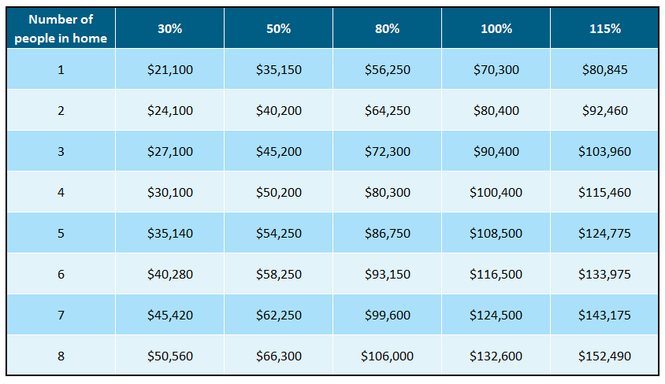
2023 Area Median Income (AMI) Levels
HUD creates regions for calculating AMI. The income limits for Pittsburgh are based on incomes in the Pittsburgh MSA – Allegheny, Armstrong, Beaver, Butler, Fayette, Washington, and Westmoreland Counties.
½ of funds allocated to 30% AMI or below
¼ of funds allocated to 50% AMI or below
¼ of funds allocated to 80% AMI or below*

Slide 5
Housing Opportunity Fund Allocations
2018 – Present
 | 2018 AAP | 2019 AAP | 2020 AAP | 2021 AAP | Add’l 2021 HOF Funding | 2022 AAP | 2023 AAP | Total HOF Funds
Rental Gap Program | $3,875,000 | $3,750,000 | $4,500,000 | $4,100,000 | $750,000 | $3,800,000 | $3,815,000 | $24,590,000
For Sale Development Program | $1,250,000 | $1,250,000 | $500,000 | $735,000 | - | $950,000 | $900,000 | $5,585,000
Homeowner Assistance Program | $2,375,000 | $2,200,000 | $2,485,000 | $2,340,000 | - | $2,150,000 | $2,110,000 | $13,660,000
Down Payment/Closing Cost | $750,000 | $500,000 | $500,000 | $600,000 | - | $700,000 | $550,000 | $3,600,000
Housing Stabilization Program | $750,000 | $800,000 | $1,015,000 | $575,000 | $58,000 | $525,000 | $550,000 | $4,273,000
Demonstration Program | - | $500,000 | - | $200,000 | $400,000 | - | $175,000 | $1,275,000
Small Landlord Fund | - | - | - | - | - | $425,000 | $400,000 | $825,000
Legal Assistance Program | - | - | - | $450,000 | $550,000 | $450,000 | $500,000 | $1,950,000
Admin | up to $1M | up to $1M | up to $1M | up to $1M | $200,000 | up to $1M | Up to $1M | $6,200,000
Total | $10,000,000 | $10,000,000 | $10,000,000 | $10,000,000 | $1,958,000 | $10,000,000 | $10,000,000 | $61,958,000

Slide 6
Housing Opportunity Fund Programs

Slide 7

Down Payment & Closing Cost Assistance
The Down Payment and Closing Cost Assistance Program (DPCCAP) provides financial assistance to first-time homebuyers in the City who are interested in purchasing an existing or newly constructed residential unit.
HOF Down Payment and Closing Cost Assistance Program
Funding Amount | 80% AMI or below – $7,500 80% - 115% AMI – $5,000
Funding Terms | 80% AMI or below – 0% interest, 5-year deferred 80% - 115% AMI – 0% interest, 10-year deferred
Requirements | Must be owner-occupied Must complete homebuyer education course Home must be located in the City

Slide 8
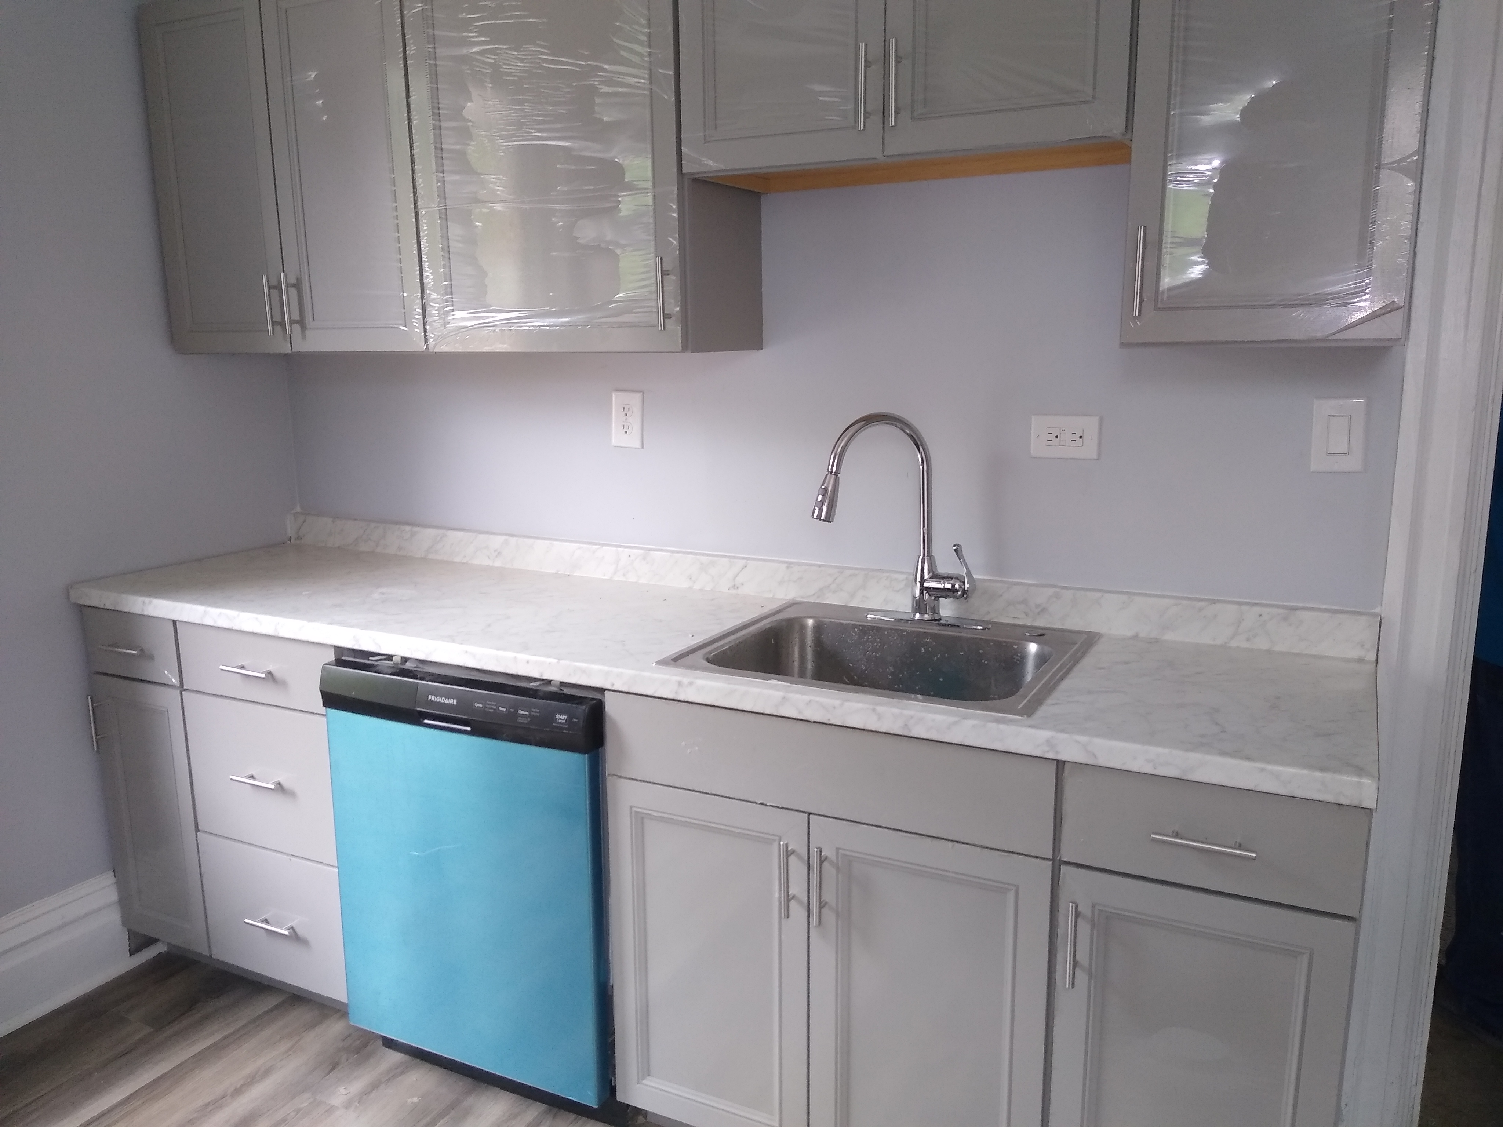
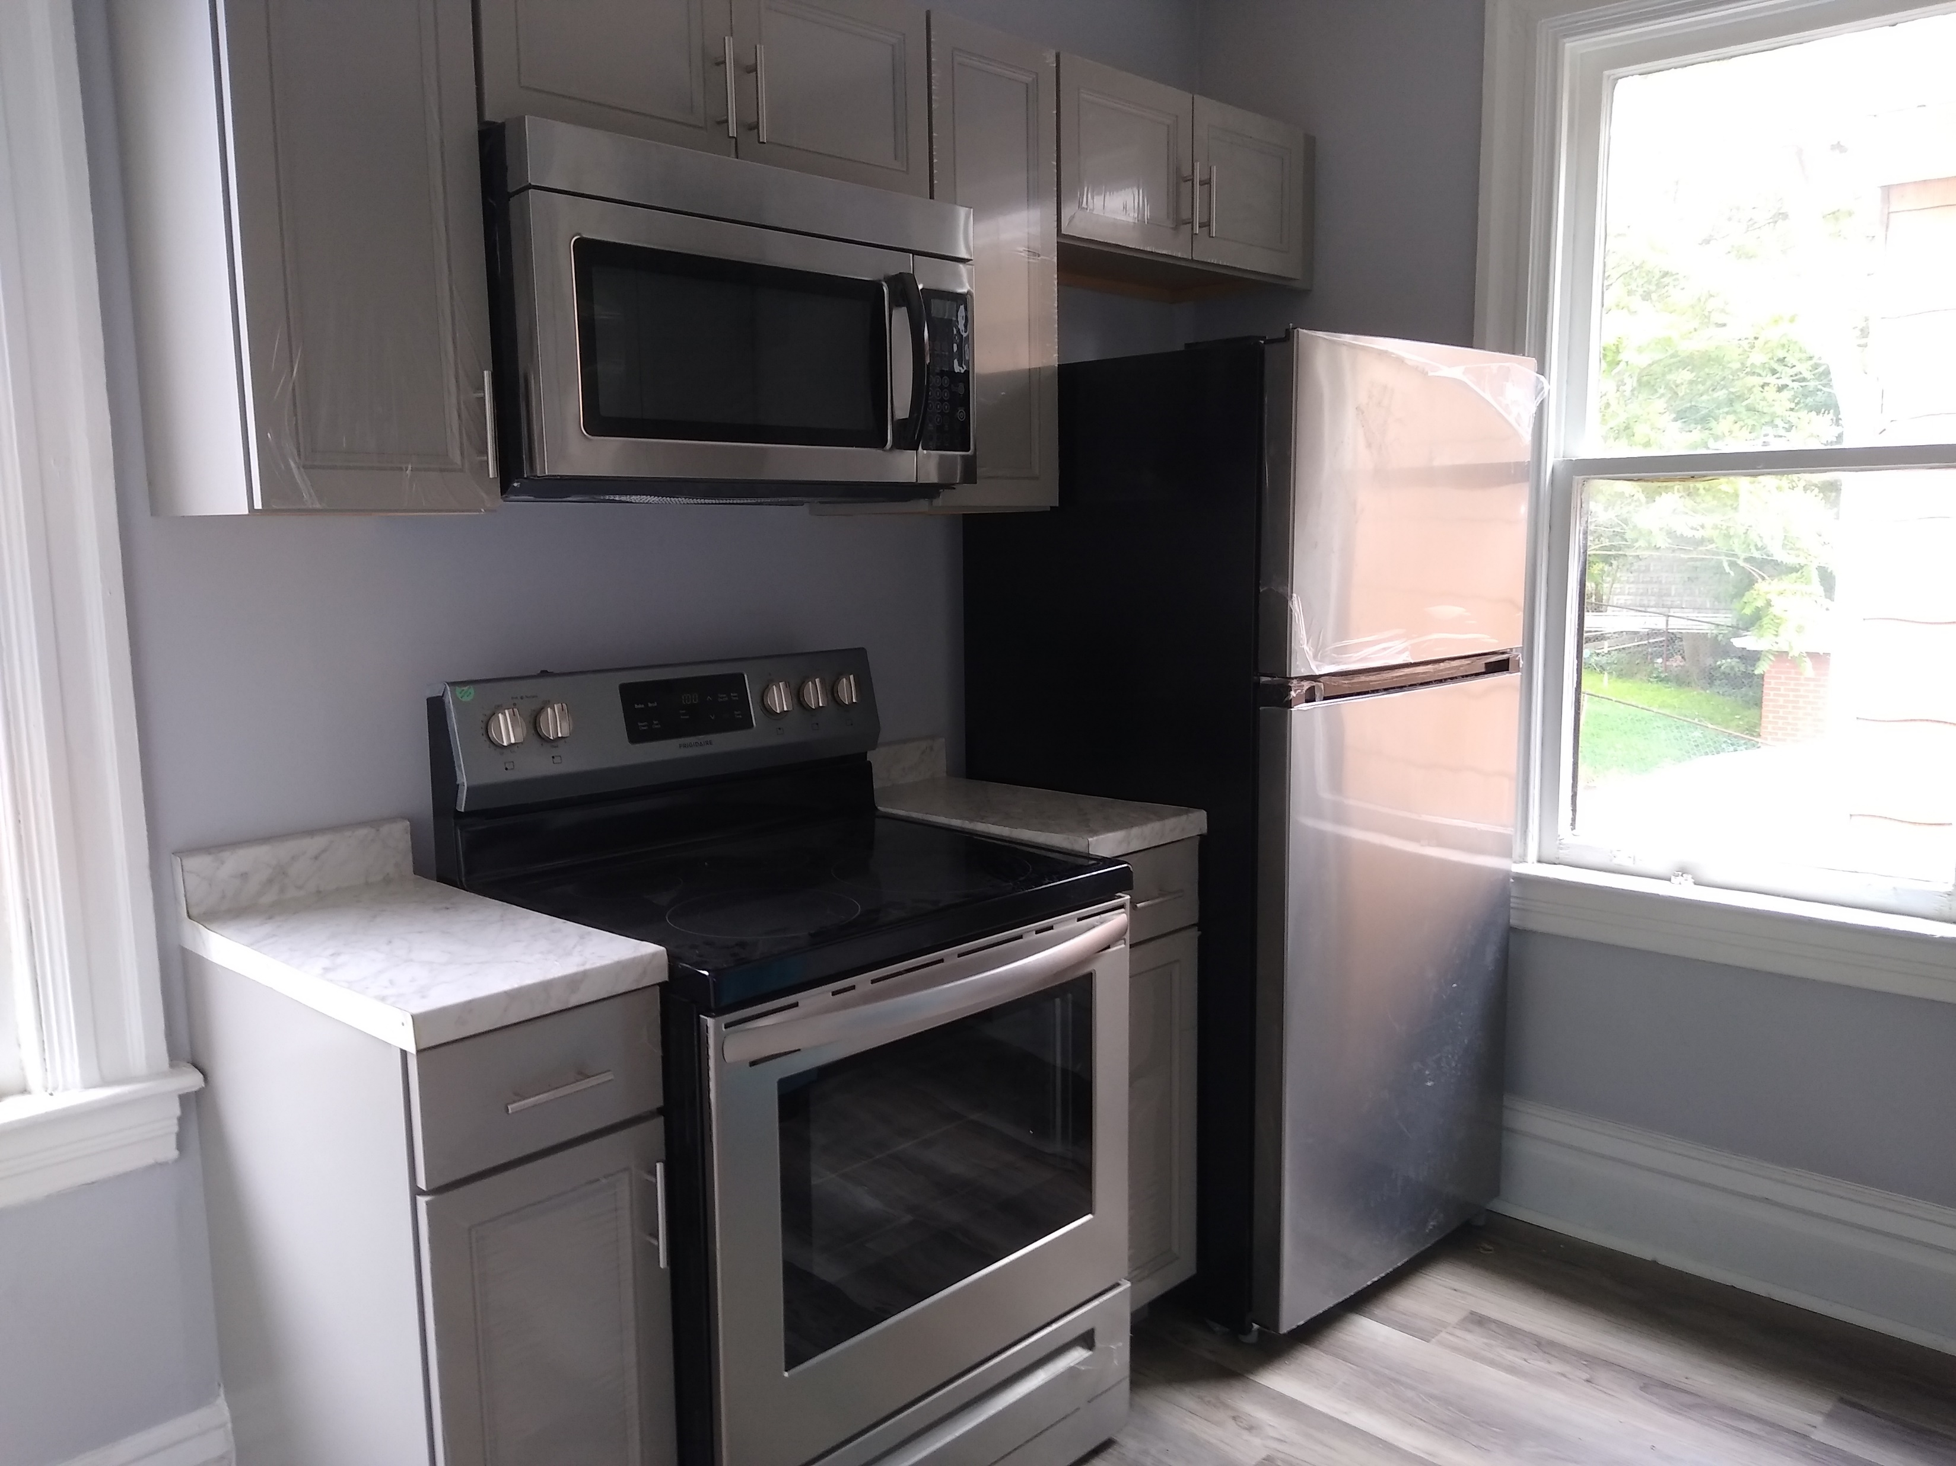
Homeowner Assistance Program
The Homeowner Assistance Program (HAP) provides financial assistance up to $35,000 to homeowners at or below 80% AMI for rehabilitating and improving residential owner-occupied properties within the City of Pittsburgh. HAP provides deferred 0% interest loans that may be used for the following:
To bring homes into compliance with City of Pittsburgh codes
To undertake energy efficiency improvements
To undertake eligible general property improvements
Open to receiving applications from June 26th until August 4th

Slide 9


Housing Stabilization Program
The Housing Stabilization Program (HSP) is a housing crisis prevention program designed to promote the economic independence of renters and homeowners experiencing a temporary, non-recurring crisis by providing limited, short-term financial assistance to help them access and/or maintain safe, stable, and affordable permanent housing.
Who may be eligible for the Program?
Renters at or below 50% AMI who live in the City or will be moving into the City
Homeowners at or below 80% AMI who live in the City

Slide 10
Legal Assistance Program
The Legal Assistance Program (LAP) provides a variety of free housing legal services to eligible tenants and homeowners who live in the City of Pittsburgh.
Legal Services for Tenants
Mediation
Limited legal representation
Full legal representation
Who do I contact for legal assistance?
Please call (412) 255-6694 ext 6721 to receive a referral.
For Spanish, Portuguese, or other languages, call:
412-530-5244
Language interpretation services are available for 40+ languages. No one will be denied services based on citizenship status.
Legal Services for Homeowners
Tangled title
Foreclosure prevention

Slide 11
Small Landlord Fund
The Small Landlord Fund Program (SLF) provides financing to landlords who own and need to make repairs to ten (10) or less rental units in the City of Pittsburgh
Funding Terms​
Loan Amounts​ | Up to $20,000 per unit​ Up to $100,000 per project​
Interest Rate​ | 0%​
Loan Term​ | 10 year term​ *The affordability period shall remain in effect should the principle of the loan be paid of prior to the loan expiration date​
Requirements​ | Must agree to rent units to HCV holders or households at 80% AMI or below​

Slide 12
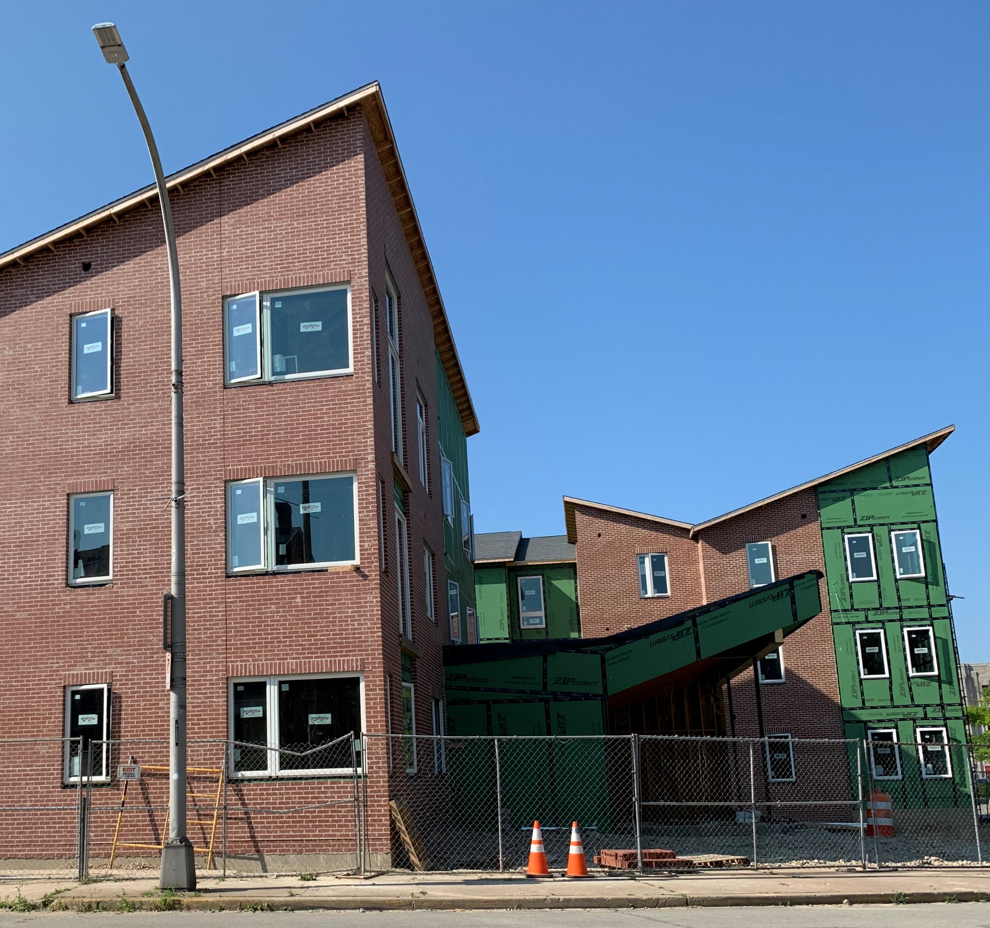
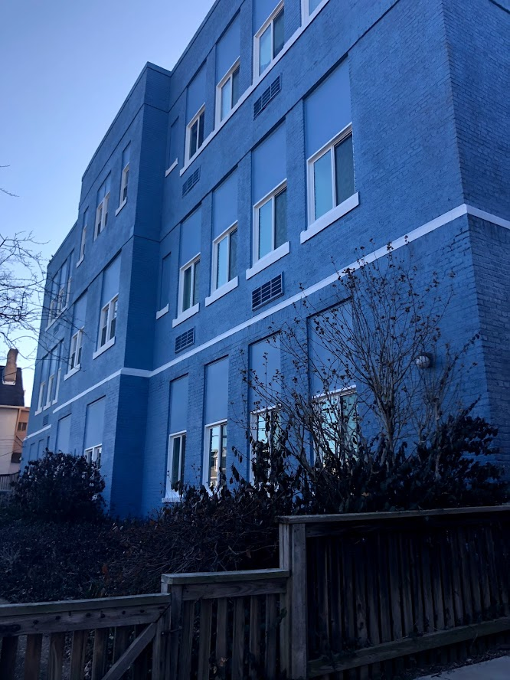
Rental Gap Program
The Rental Gap Program (RGP) provides loans to developers/nonprofit applicants for the creation and/or preservation of affordable units.
The RGP is designed to increase the supply of affordable rental housing.

Slide 13
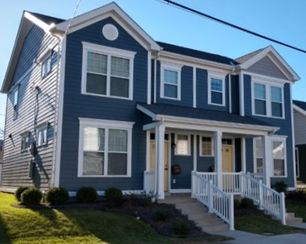
For-Sale Development Program
The For-Sale Development Program (FSDP) provides low interest rate construction financing and/or grants for the purpose of increasing the supply of affordable housing for homeownership and to eliminate substandard housing by ensuring compliance with applicable codes and standards.

Slide 14
Other URA Housing Programs

Slide 15
OwnPGH Homeownership Program
The OwnPGH Homeownership Program (OwnPGH) provides up to $90,000 to first-time homebuyers seeking to purchase a home within the City of Pittsburgh.
OwnPGH Homeownership Program
Funding Amount | Up to $50,000 Grant Up to $40,000 Loan
Funding Terms | 80% AMI or below 0% interest, 10-year forgivable loan
Requirements | Must be pre-qualify for home loan through one of three bank partners (First Commonwealth Bank, SSB Bank, Dollar Bank Would like to own a property in the City of Pittsburgh

Slide 16
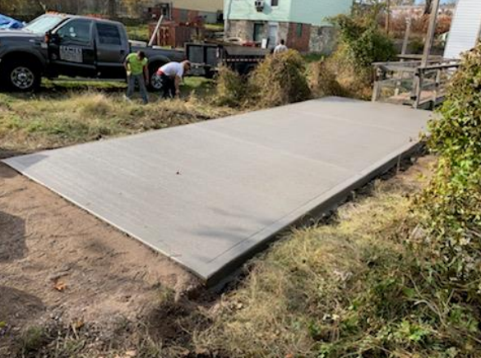
Home Accessibility Program for Independence (HAPI)
The Home Accessibility Program for Independence (HAPI) is a grant program up to $15,000 to assist eligible homeowners and landlords to construct accessibility modifications to their homes.
Accessible modifications include but are not limited to:
Exterior Ramps
Chair Gliders or Lifts
Door Widening
Bathroom Modifications
Lowering Kitchen Counters
Sliding Shelves
Visual Door Bells
Visual Phone Signalers
Notes:
Eligible homeowners may receive a grant from $1,000 up to $10,000 for a single unit home. Landlords may receive a grant up to $5,000 per unit.

Slide 17

Public Survey: Pittsburgh Affordable Housing
We want to hear from you on how these housing programs can best address the needs in your community!
Online:
English: https://bit.ly/hof2024eng
Spanish: https://bit.ly/hof2024span
Email for paper copy: Hof@ura.org
Phone: 412-420-6379
QR Code on next Slide:

Slide 18
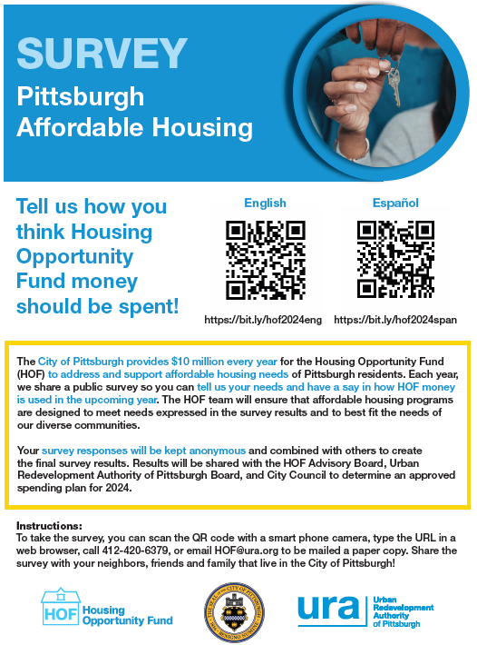

Slide 19
Questions?
Contact the HOF at hof@ura.org or at (412) 255-6694, ext 6721

