Slide 1
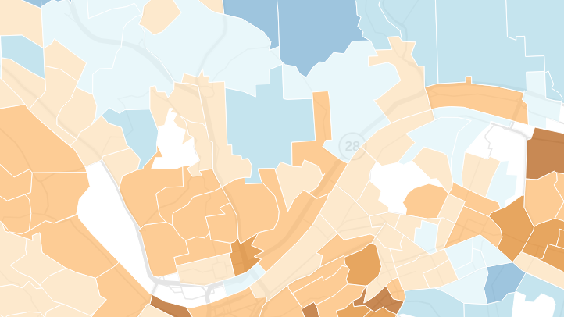
NAVIGATING UNEMPLOYMENT DURING COVID-19
Sara Innamorato
State Representative
21st District, Pennsylvania House of Representatives

Slide 2
Outline
Unemployment Compensation (UC) Context + History
Application Process
Frequently asked questions
Updates to UC + PUA + FPUC

Slide 3
Hello!
Notes:
How did we get here?
We've been divesting and under investing in our public benefit and the critical infrastructure necessary for the departments to deliver these entitlements.
We had to shut down life as we know it, because we do not a have a strong public health infrastructure in PA.
10 years ago we signifigantly cut funding for UC and closed

Slide 4
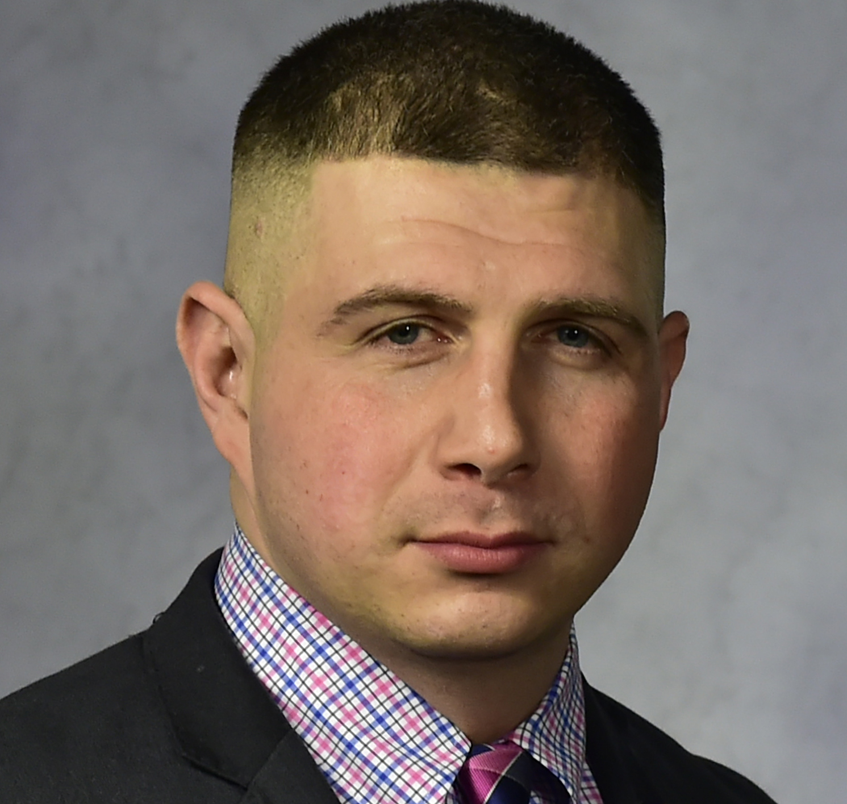
District 21 Team
Kenneth Aquiline
District Office Manager
Lawrenceville Office
Kristin Goddard
Constituent Services Specialist
Lawrenceville Office
Victoria Baltimore
Legislation Assistant
Harrisburg Office

Slide 5
Terminology
Unemployment Compensation
Federal CARES Act
Pandemic Emergency Unemployment Compensation (PEUC)
Pandemic Unemployment Assistance (PUA)
Federal Pandemic Unemployment Compensation (FPUC)
Notes:
The federal CARES Act was signed into law March 27, 2020. The Act provides enhanced Unemployment Compensation (UC) benefits and Pandemic Unemployment Assistance (PUA) for Pennsylvanians.
FPUC = the additional $600/month
PUA = expanded eligibility for individuals who have traditionally been ineligible for unemployment benefits (e.g. self-employed workers, independent contractors, gig workers).
Pandemic Emergency Unemployment Compensation (PEUC) = an additional 13 weeks of unemployment on top of the 26 for a total of 39 weeks of unemployment. This is for those who have exhausted unemployment benefits.
this is the extra $600/month that was contained in the Federal CARES Act

Slide 6
March 6, 2020
Gov. Wolf declares Disaster Emergency
March 27, 2020
Passage of federal CARES Act
April 27, 2020
1.65 Million PA workers filed for UC + 107,000 filed for PUA
March 19, 2020
Gov. Wolf declares all non-essential businesses to close
April 18, 2020
PUA + PEUC Launches
in Pennsylvania
Notes:
The federal CARES Act was signed into law March 27, 2020. The Act provides enhanced Unemployment Compensation (UC) benefits and Pandemic Unemployment Assistance (PUA) for Pennsylvanians.
The state’s unemployment compensation system has paid out $3.5 billion in benefits since mid-March, when Gov. Tom Wolf ordered nonessential businesses to close to slow the spread of the coronavirus. Of that figure, roughly $2.6 billion has been for standard unemployment claims, and another $900 million on the extra $600 per week provided in the federal coronavirus relief legislation.
You may be eligible if:
Your employer temporarily closes or goes out of business because of COVID-19
Your employer reduces your hours because of COVID-19
You have been told not to work because your employer feels you might get or spread COVID-19
You have been told to quarantine or self-isolate, or live/work in a county under government-recommended mitigation efforts
Pandemic Unemployment Compensation (FPUC) - Additional Benefits An additional $600 per week, on top of regular benefits, to all UC recipients
L&I has made about $490 million payments so far under the $600 FPUC
Pandemic Unemployment Assistance (PUA) - Self-Employed, Contractors Expanded eligibility for individuals who have traditionally been ineligible for UC benefits (e.g., self-employed workers, independent contractors)
Pandemic Emergency Unemployment Compensation (PEUC) - For UC Benefit Exhaustees An additional 13 weeks of UC benefits, beyond the regular 26 weeks already provided, for a total of 39 weeks of coverage.

Slide 7
You may qualify for unemployment if you...
were laid off or furloughed
lost one of your jobs
are a business owner
are an independent contractor
are an UBER or Lyft driver
collect SSI/SSDI
collected unemployment this year

Slide 9
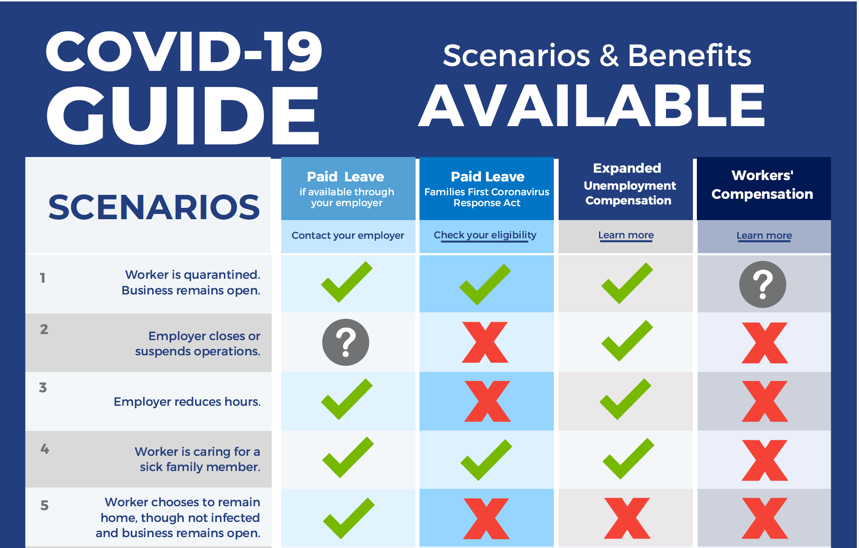

Slide 10
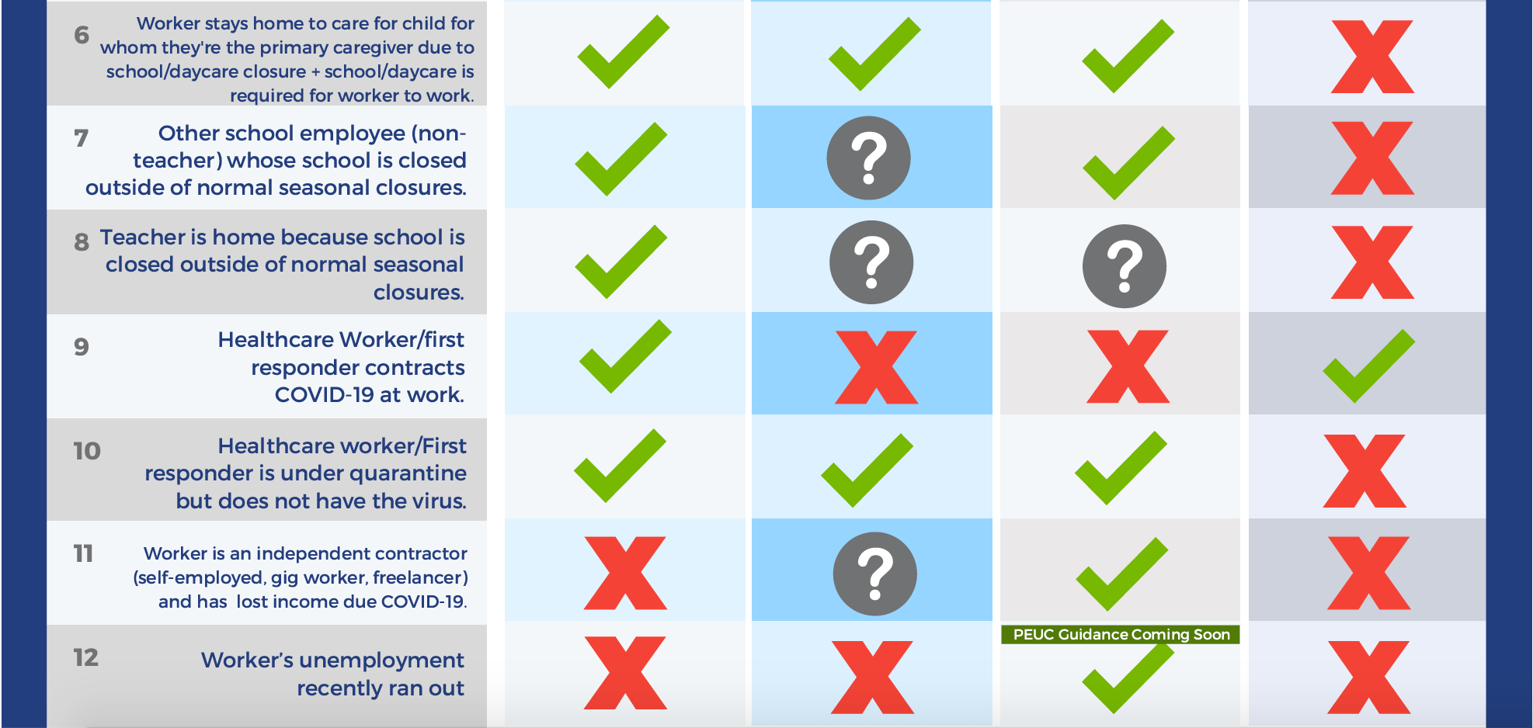

Slide 11
UNEMPLOYMENT COMPENSATION
File online at uc.pa.gov
If you are eligible for UC, you will receive two letters and a four-digit PIN by MAIL
Your PIN will arrive in the U.S. mail – keep it in a safe, easy to remember place
If approved, your first benefit payment should arrive within four weeks of filing for UC
Continue filing your bi-weekly claim (every two weeks) – even while waiting for approval
If you are having problems, you can e-mail UC at uchelp@pa.gov or use chat
For specific questions about your claim, provide your full name (as it appears on your claim, including any suffix used) and the last four digits of your Social Security Number.
Note: Duplicative emails and/or requests may cause delays.
Notes:
The following rules have been temporarily suspended due to Governor Tom Wolf's emergency declaration to make it easier to file for UC benefits:
Work Search and Work Registration requirements are temporarily suspended for all UC claimants. Claimants are not required to prove they have applied or searched for a new job to maintain their UC benefits. Claimants are also not required to register with PACareerLink.pa.gov.
The Waiting Week is temporarily suspended for all UC claimants. Previously, eligible claimants would not receive compensation for the first week of unemployment. Eligible claimants may now receive benefits for the first week that they are unemployed.

Slide 12
UC: UPDATES + ISSUES
An additional $600/week until July 25, 2020 (beginning April 4, 2020) will automatical begin to appear.
If you awaiting a return phone call, save UC's 888-313-7284 number in your phones so that they do not miss a call from UC
If you need to contact UC you can call (888-313-7284), email (uchelp@pa.gov), or use the chat function on the UC website (uc.pa.gov).

Slide 13
PANDEMIC UNEMPLOYMENT ASSISTANCE
Apply on uc.pa.gov
Retroactive pay, as early as to January 27, 2020
Benefit amounts would be calculated based on previous income and will be between $195-$572
Payments to begin early May
Also be eligible for the additional $600 weekly benefit
Does not cover those able to work from home
Expands eligibility though 39 weeks of pay
Not eligible if receiving PTO or paid sick leave, etc.
Notes:
Pandemic Unemployment Assistance (PUA)
The application is functional right now; but the benefit system is still under construction.
Approximately 170,000 successful PUA applications since April 18.
Improvements continue to be made to the system.
The goal is to have payments going out in early May.
40,000+ applicants were originally directed to the legacy UC system. L&I addressed the issue and reported that about 37,000 individuals have gone back and applied for PUA successfully.
Claimants are not currently seeing an accurate determination amount. As soon as the backend is matched to the frontend of the system, claimants will see what they are eligible for and not the default $195 that is on the dashboard currently.
People will need to file weekly continued claims to get payments once the benefit system is operating.
L&I is working to figure out PUA log-in issues.

Slide 14
PUA: PROOF OF SELF-EMPLOYMENT
Including, but not limited to:
copies of recent paycheck stubs;
bank receipts showing deposits;
1099s;
billing notices provided to your customers;
recent advertisements for your business or services;
statements from recent customers;
current business licenses, ledgers, contracts, invoices; and/or
building leases.

Slide 15
PUA: PROOF OF INCOME
Including, but not limited to:
tax returns
paycheck stubs
bank receipts
ledgers
contracts
invoices
billing statements

Slide 16
PUA: UPDATES + ISSUES
The system does allow people to log back in and add new information; however, the department is aware of log-in issues.
If a claimant is frozen out of the PUA application and needs to provide additional information on their claim, they have two options:
1) Wait until the glitch is fixed and add the information then – PUA claims are not being processed yet anyway; or
2) Send a detailed email explaining the situation and attaching the documents to ucpua@pa.gov if they want to do something right away.
Some claimants have multiple sources of income. The PUA application asks for total quarterly income. Claimants should add up their sources of income. Claimants do not need to enter each source of income separately.
Notes:
80 people are being transferred from the Dept. of Revenue to help with PUA applications. L&I is hiring 100 additional intermediate intake interviewer

Slide 17
COMMON ISSUES
I have not received my PIN.
Claimants who filed in March who have yet to receive a PIN: L&I notified us that 19,000 claimants incorrectly filed their application (misspelled name, name in the wrong box, incorrect address, incomplete social security number).
Because these claims included incorrect information, the Social Security Administration was not able to “build” the claim. This means that L&I has to manually identify those claims and fix them internally.
If it has been more than a month and you still have not received your PIN, contact our office for help
Cannot File Bi-Weekly Because Established Claim Is Not Active
There are approximately 160,000 reopened UC claims that will be fixed over the weekend and will knock out a significant chunk of backlog – about 200,000 or more.
If your claim has been “established but is inactive” for more than three weeks, contact our office for help.
Notes:
80 people are being transferred from the Dept. of Revenue to help with PUA applications. L&I is hiring 100 additional intermediate intake interviewer

Slide 18
DISTRICT 21 UPDATES
Primary is June 2
Mail-in Ballot VotesPA.gov
Census Update
10th Ward = 49%
9th Ward = 55%
6th Ward = 45%
Mycensus2020.gov
Weekly Calls
Community Groups
Small Businesses
Local Government
Notes:
80 people are being transferred from the Dept. of Revenue to help with PUA applications. L&I is hiring 100 additional intermediate intake interviewer

Slide 19
DISTRICT 21
412.781.2750
FB: RepInnamorato
IG: Rep Innamorato
TW: @RepInnamorato

